Slide 1
1.
Auto ML Overviews

Slide 2
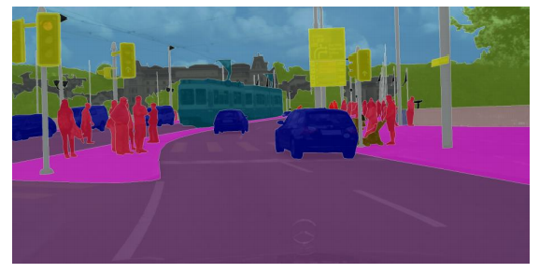

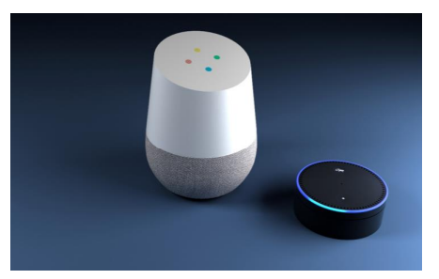

Successes of Deep Learning
Computer vision tasks
(Segmentation task- Cityscapes dataset)
Image source
Recommendation System -YouTube image source
Speech Recognition
(Google-Home, Amazon Alexa)
Image source
Robotics Industrial Application image source

Slide 3

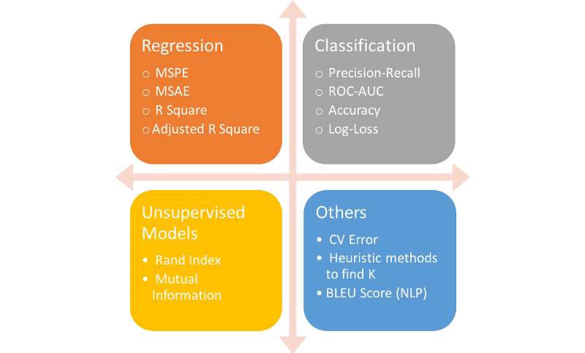

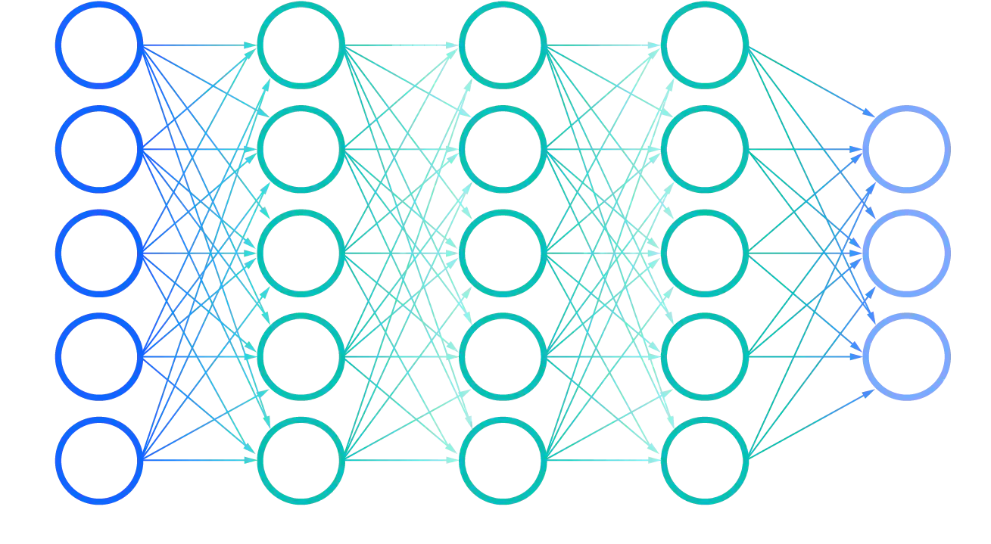
Deep Learning General Pipeline Design
DL Expert Design Architecture & Hyperparameter Defines
Model
Performance-Evaluation
Dataset Inputs
Deep Neural net
Evaluate Performance (Metrics)

Slide 4
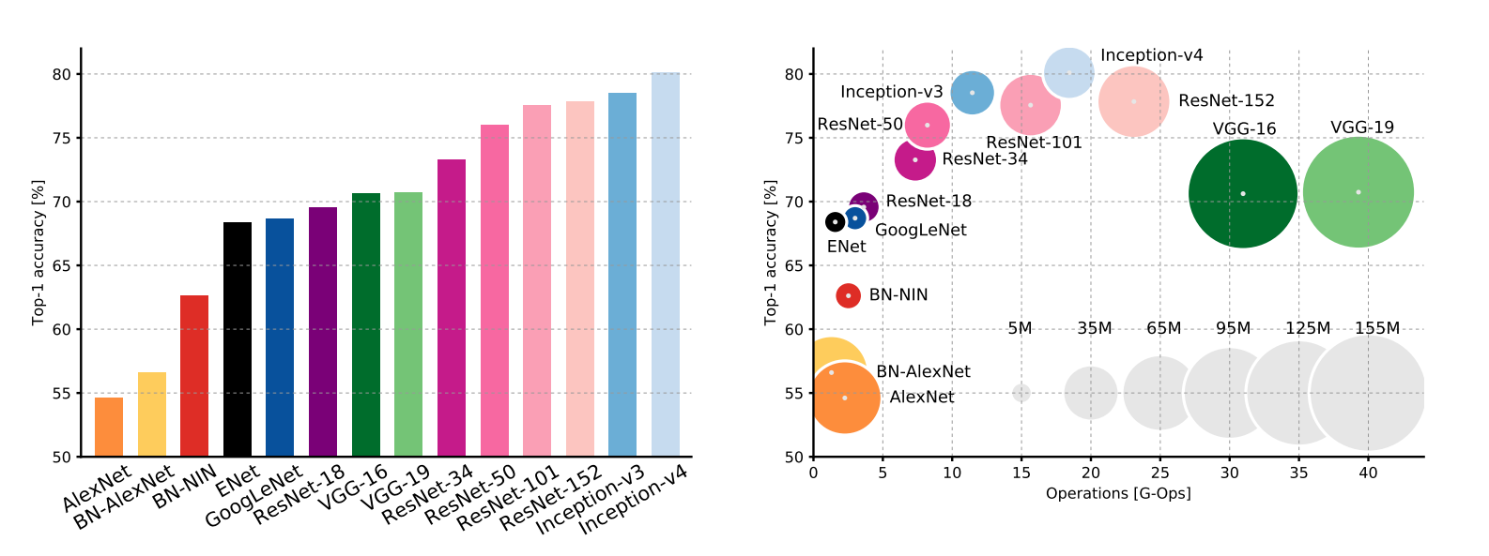
Decades of Development Deep Neural Net
Canziani et al. 2017

Slide 5
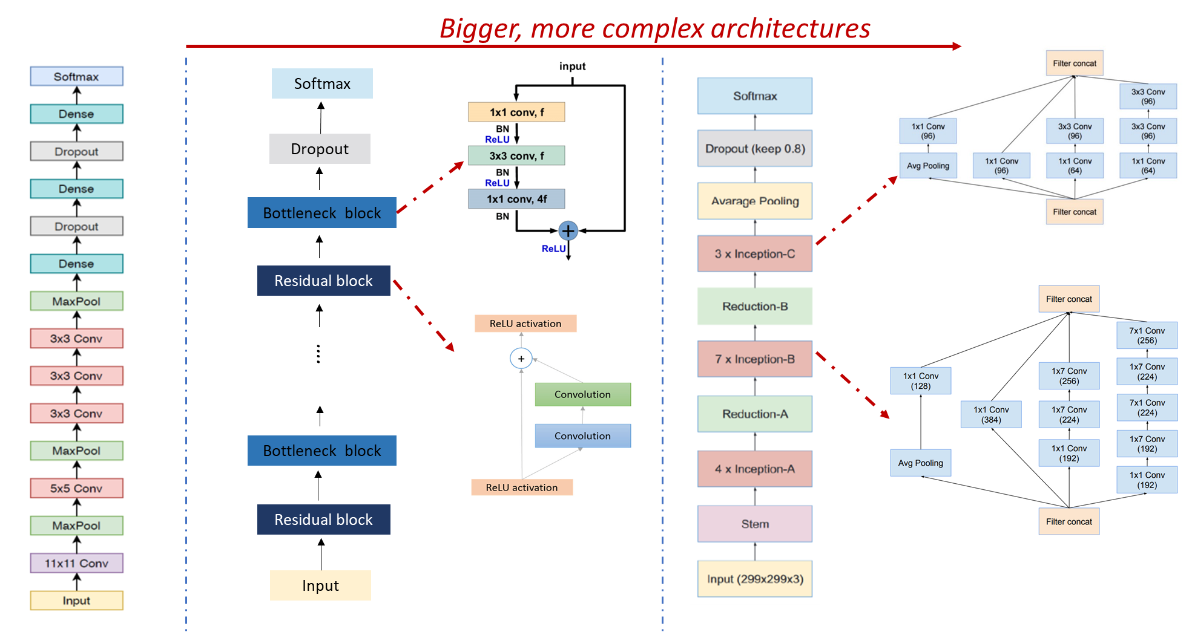
Design Deep Neural Architecture
AlexNet Krizhevsky et al.
NeurIPS 2012
ResNet He et al. CVPR
2015
Inception-V4 Szegedy et al. AAAI
2017

Slide 6
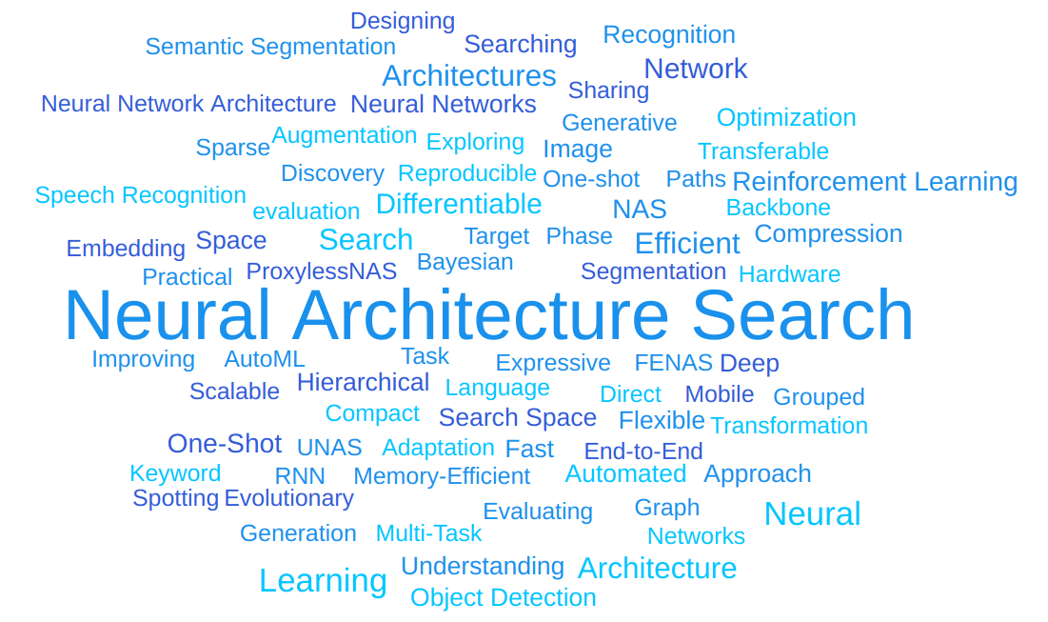
Image- public domain
Link Access

Slide 7

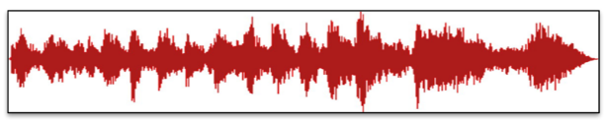

AutoML (NAS) General Pipeline
Meta-Learning Optimizations
Multi-Objectives Learning & Optimization
Image- public domain
Link Access
Images
Learning Box
Audio
Text
+ Efficient design
+ Faster Generate better model
+ Multi-level applications architectures
+reproducible

Slide 8
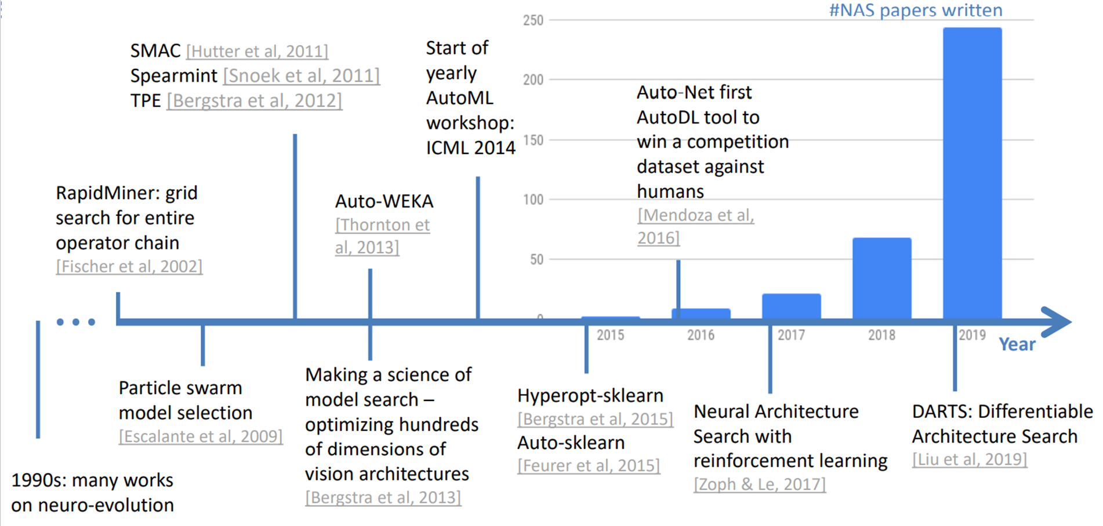
Overview Auto ML – Timeline Development
Re-produce slide from
http://www.automl.org/talks

Slide 9
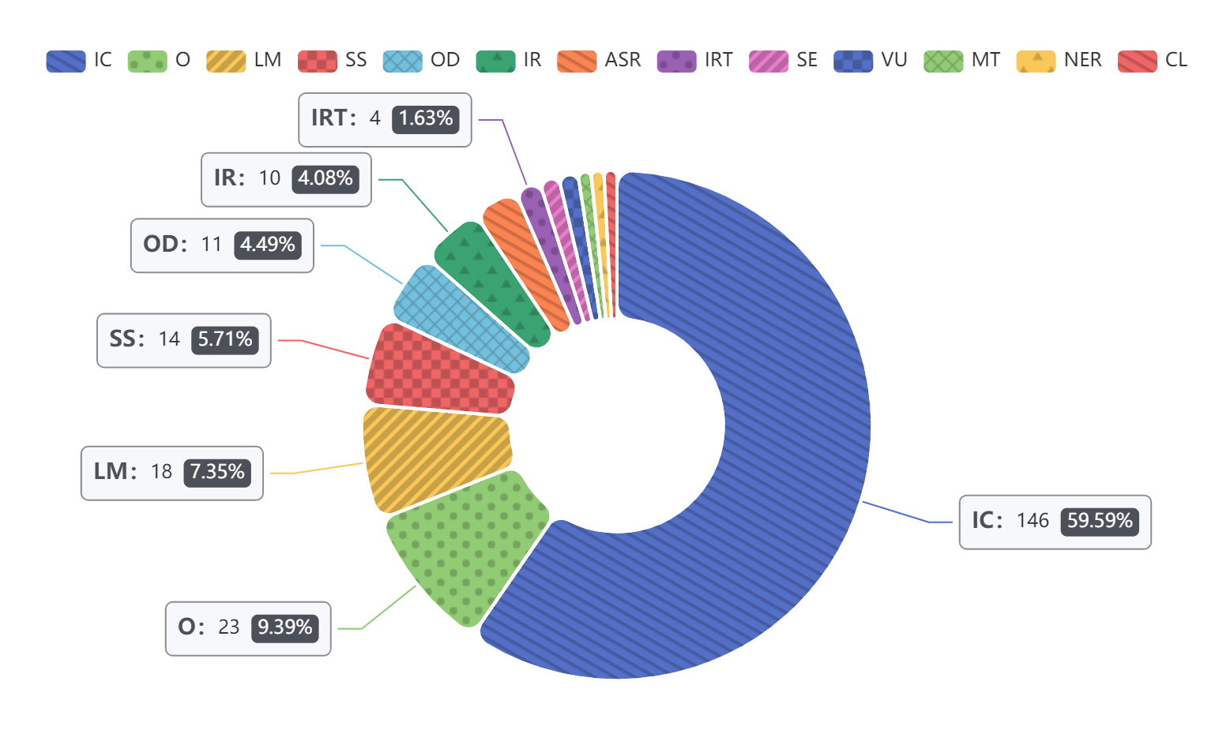
AutoML (NAS) – Task Domains
ASR (Automatic Speech Recognition)
CL(Scene, Point Cloud, Classification)
IC (Image Classification)
IR (Image Recognition)
IRT (Image Restoration)
LM (Language Model)
MT (Machine Translation)
NER (Named Entity Recognition)
OD (Object Detection)
SE (Instance Segmentation)
SS (Semantic Segmentation)
VU (Video Understanding)
Image- public domain
Link Access
The Number of NAS for Different Domains Tasks Area in Recent Years (2017-2020).

Slide 10
2.
NAS Techniques

Slide 11
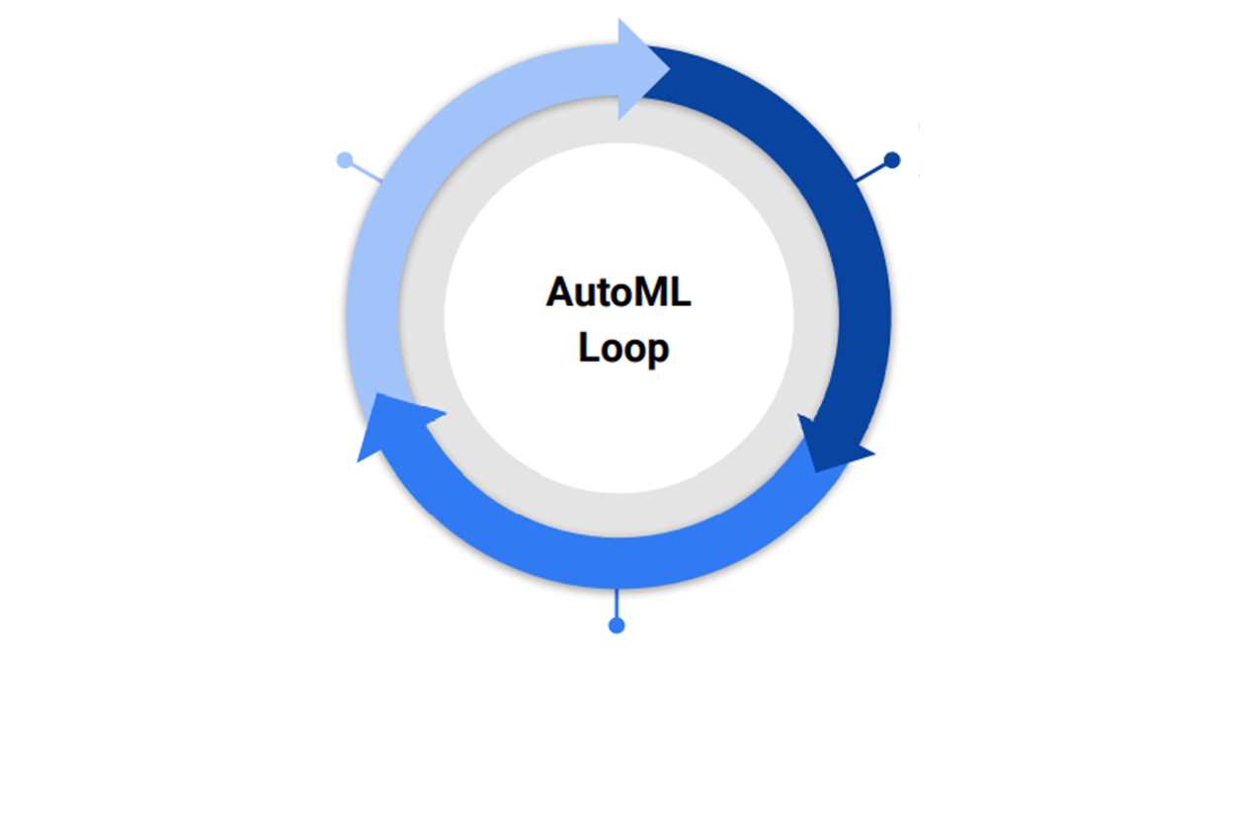
AutoML (NAS) – Building Blocks
Search Space
Search Algorithm
Evaluation Strategy

Slide 12
NAS– Search Space
Sequential Layer-Wise Operations
Hierarchical Branches- Connections operations
Cell- Based Operations
4. Others

Slide 13
1. Sequential Layers-Wise Operations

Slide 14
NAS– Search Space
1. Sequential Layers-Wise Neural Network Architecture
Input
Output

Slide 15
NAS– Search Space
1. Sequential Layers-Wise Neural Network Architecture
Input
L1
➔ Sequentially stack different layers to create Neural Net Architecture.
L2
…..
L_N
Output

Slide 16
NAS– Search Space
1. Sequential Layers-Wise Neural Network Architecture
Input
Filter
Kernel size
Input
L1
Convolution
Layer type: Convolution layer
L2
…..
L_N
Output

Slide 17
NAS– Search Space
1. Sequential Layers-Wise Neural Network Architecture
Illustration of a General Convolution Block
Input
Input
Filter
Kernel size
L1
Convolution
Layer type: Convolution layer
L2
Bias Add
…..
Activation
(ReLu, Sigmoid)
L_N
Normalization (BN)
Output

Slide 18
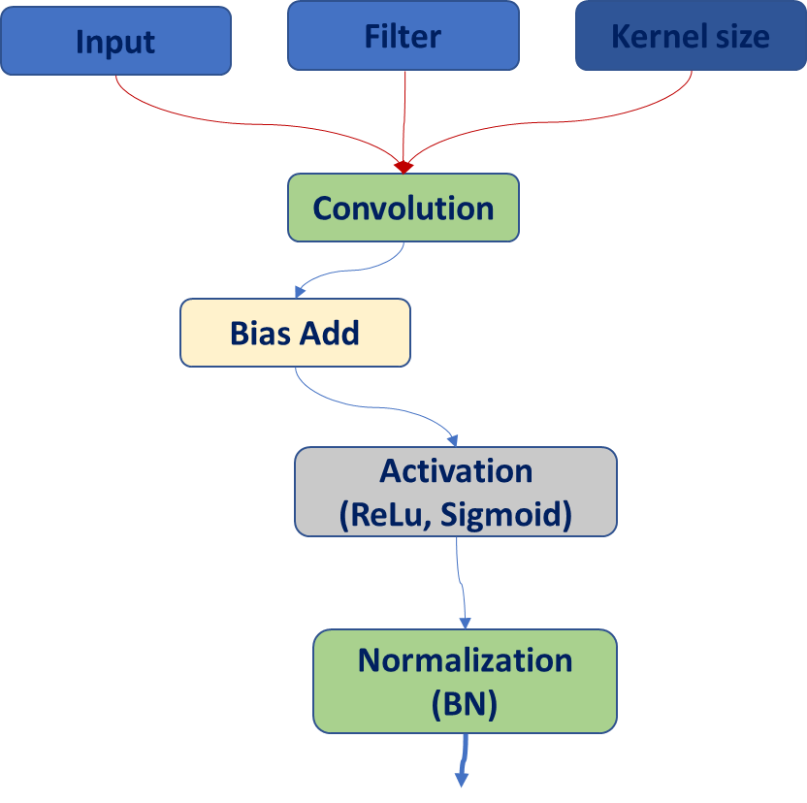
NAS– Search Space
1. Sequential Layers-Wise Neural Network Architecture
Input
L1
Layer type: Convolution layer
L2
Layer type: Maxpool layer
Maxpooling Layer
…..
L_N
Type N Layer
Layer type: Type N layer
Output

Slide 19
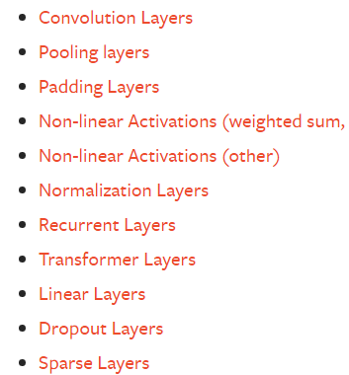
NAS– Search Space
1. Sequential Layers-Wise Neural Network Architecture
Multiple Operation Layer types
Input
L1
Layer type: Convolution layer
L2
Layer type: Maxpool layer
…..
L_N
Layer type: Type N layer
Tensorflow Keras – layers API
https://keras.io/api/layers/
Output
Pytorch layers API
https://pytorch.org/docs/stable/nn.html

Slide 20
NAS– Search Space
1. Sequential Layers-Wise Neural Network Architecture

Slide 21
2. Complex Hierarchical Structure - Connections Neural Network Architecture

Slide 22
NAS– Search Space
2. Complex Hierarchical Structure - Connections Neural Network Architecture
Input
L1
L2
Layer type: Convolution layer
Output

Slide 23
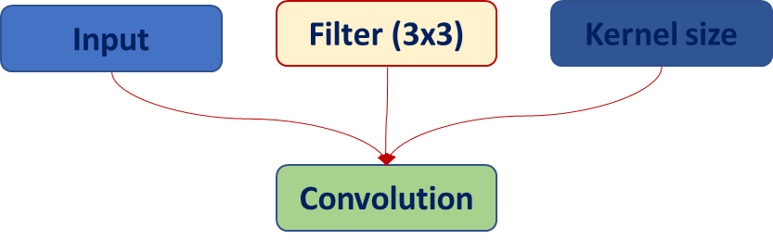
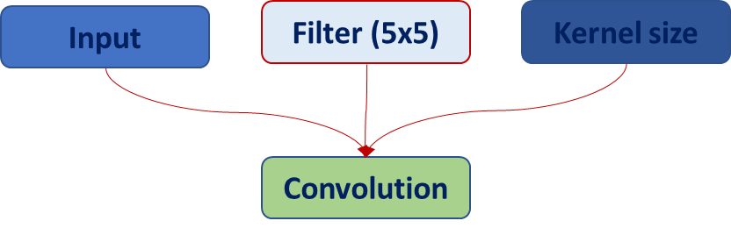
NAS– Search Space
2. Complex Hierarchical Structure - Connections Neural Network Architecture
Input
L1
L2
Output

Slide 24
NAS– Search Space
2. Complex Hierarchical Structure -Connections Neural Network Architecture
Input
Multiple Operation Layer types
L1
L2
Layer type: Convolution layer
L3
Layer type: Maxpool layer
Tensorflow Keras – layers API
https://keras.io/api/layers/
Pytorch layers API
Output
https://pytorch.org/docs/stable/nn.html

Slide 25
NAS– Search Space
2. Complex Hierarchical Structure -Connections Neural Network Architecture
Input
Architecture Layer types
L1
L2
Connections & Multiple Branches
L3
[‘Skips Connections’]
[‘Branches each layers’]
L4
L5
L6
…..
Tensorflow Keras – layers API
L_N
https://keras.io/api/layers/
Pytorch layers API
Output
https://pytorch.org/docs/stable/nn.html

Slide 26
NAS– Search Space
2. Complex Hierarchical Structure -Connections Neural Network Architecture
The combination of Possibility model architecture

Slide 27
3. Block -> Cell Neural Network Architecture

Slide 28
NAS– Search Space
3. Block -> Cell Neural Network Architecture
Input
Block-> Cell
Block
Cell
Network Architecture
Output

Slide 29
NAS– Search Space
3. Block -> Cell Neural Network Architecture
Input
Block
Cell
Network Architecture
Cell Type 1
Cell 2 Type 2
+ Once cell structure is defined
Neural Network Architecture stack it up using a predefined pattern.
+ A Network is fully specified with:
Cell Structure
N (number of Cell repetition)
Number of N can be predefined
…..
Cell Type 2
Output

Slide 30
NAS– Search Space
3. Block -> Cell Neural Network Architecture
An Example of Cell
Input
Input 1
Input 2
Cell 1
Concatenate
Cell 2
Block 2
…..
Block 1
Block 1
Cell N
Output
Concatenate

Slide 31
NAS– Search Space
3. Block -> Cell Neural Network Architecture
Example structure of Block
Operator 1 b and Operator 2, Operator 3 :
○ 3x3 Convolution2D
○ 5x5 Depth-separable convolution
○ 7x7 Depth-separable convolution
○ Identity
○ 3x3 average pooling
○ Type N operators
Input
Op 1
Op 2
Op 3
Concatenate
…….

Slide 32
NAS– Search Space
3. Block -> Cell Neural Network Architecture
Example structure of Block
Operator 1 b and Operator 2, Operator 3 :
○ 3x3 Convolution2D
○ 5x5 Depth-separable convolution
○ 7x7 Depth-separable convolution
○ Identity
○ 3x3 average pooling
○ Type N operators
Input
Op 1
Op 2
Op 3
Op 4
…….
Concatenate

Slide 33
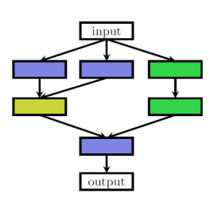
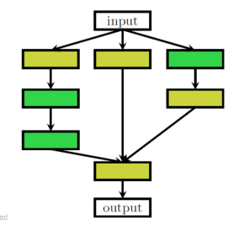
NAS– Search Space
3. Block -> Cell Neural Network Architecture
Input
Normal Cells:
Preserves the Spatial Inputs Resolution
Normal Cell
Reduction Cell
…..
Reduction Cells:
Reduce the Spatial Inputs Resolution
Normal Cell
Output

Slide 34
NAS– Search Space
3. Block -> Cell Neural Network Architecture
Input
Normal Cells:
Preserves the Spatial Inputs Resolution
Normal Cell
Reduction Cell
…..
Reduction Cells:
Reduce the Spatial Inputs Resolution
Normal Cell
Output

Slide 35
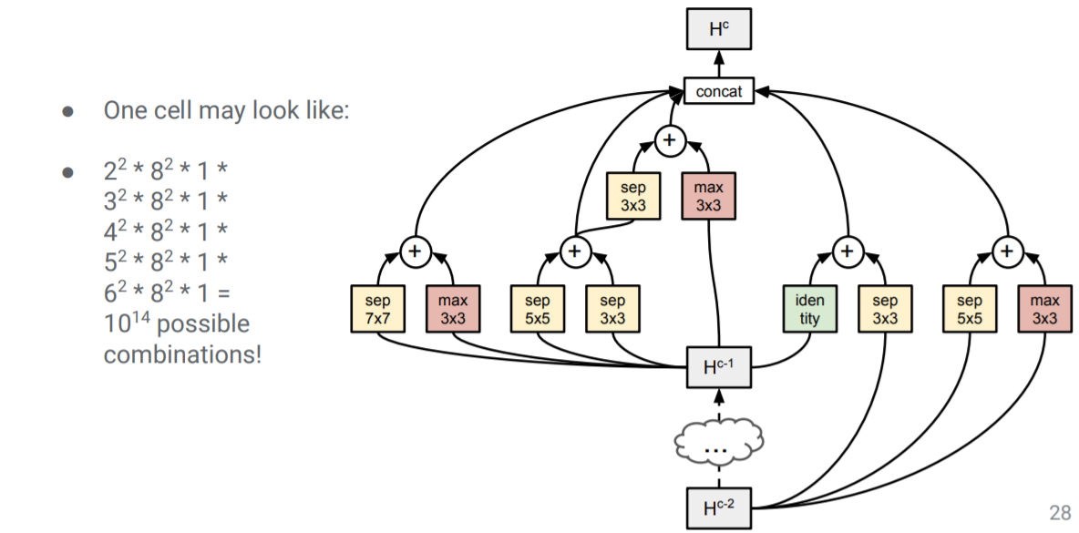
NAS– Search Space

Slide 36
How to combine different type layer & Hyperparameter ???

Slide 37
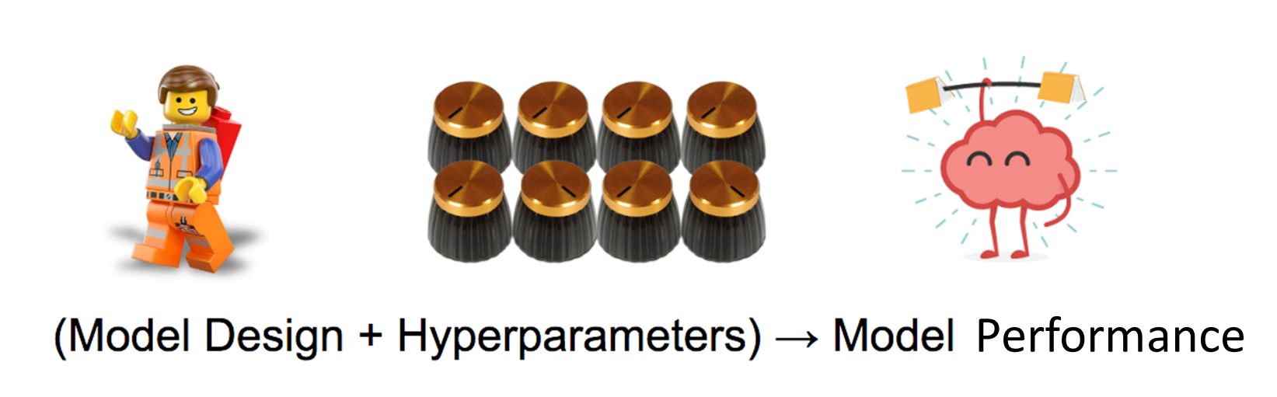
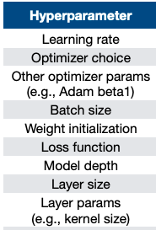
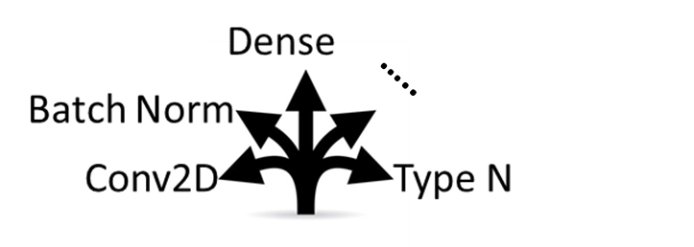
Manual Sequentially iterate through all steps(Trial & Error )

Slide 38

Manually Trial & Error Sorry We Run Out of Time
This Image is © The New York Times

Slide 39
NAS– Search Algorithms
Grid & Random Search
Reinforcement Learning Search Algorithm
Evolutionary Search Algorithm
Bayesian Search Algorithm
Gradients Descent Search
Others

Slide 40
Grid - Random Searching strategy

Slide 41
1. Grid Search Strategy
Defined grid of N dimensions, each of these maps for an Hyperparameter
Hyperparameter 2
Hyperparameter 1

Slide 42
1. Grid Search Strategy
Defined grid of N dimensions, each of these maps for an Hyperparameter.
(Learning_rate, dropout, Batch_size, optimizers etc)
Hyperparameter 2
Hyperparameter 1

Slide 43
1. Grid Search Strategy
Defined grid of N dimensions, each of these maps for an Hyperparameter (Learning_rate, dropout, Batch_size, optimizers etc)
Hyperparameter 2
Hyperparameter 1

Slide 44
1. Grid Search Strategy
Hyperparameter 1
Batchsize (4, 8, 16, 32, 64, 128, 256)
Hyperparameter 2
Learning Rate (1e-2, 1e-3, 1e-4, 1e-5, 1e-6,)
Hyperparameter 2
Hyperparameter 1

Slide 45
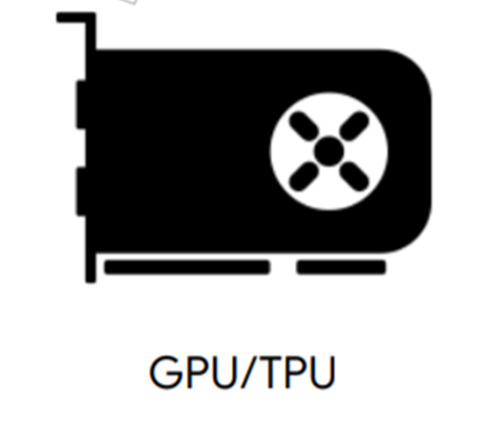
1. Grid Search Strategy
Hyperparameter 1
Batchsize (4, 8, 16, 32, 64, 128, 256)
Hyperparameter 2
Learning Rate (1e-2, 1e-3, 1e-4, 1e-5, 1e-6,)
Evaluate the performance
C1(4, 1e-4) -> result1=0.8
C2(4, 1e- 3) -> result2=0.82
C3(4, 1e-2.) -> result3=0.85
Hyperparameter 2
Hyperparameter 1

Slide 46
1. Grid Search Strategy
Hyperparameter 1
Batchsize (4, 8, 16, 32, 64, 128, 256)
Hyperparameter 2
Learning Rate (1e-2, 1e-3, 1e-4, 1e-5, 1e-6,)
Evaluate the performance
C1(4, 1e-4) -> result1=0.8
C2(4, 1e- 3) -> result2=0.82
C3(4, 1e-2.) -> result3=0.85
Hyperparameter 2
Hyperparameter 1

Slide 47
1. Grid Search Strategy
Hyperparameter 1
Batchsize (4, 8, 16, 32, 64, 128, 256)
Hyperparameter 2
Learning Rate (1e-2, 1e-3, 1e-4, 1e-5, 1e-6,)
Evaluate the performance
C1(8, 1e-4) -> result1=0.8
C2(8, 1e- 3) -> result2=0.82
C3(8, 1e-2.) -> result3=0.85
Hyperparameter 2
Hyperparameter 1

Slide 48
1. Grid Search Strategy
Hyperparameter 1
Batchsize (4, 8, 16, 32, 64, 128, 256)
Hyperparameter 2
Learning Rate (1e-2, 1e-3, 1e-4, 1e-5, 1e-6,)
Evaluate the performance
C1(16, 1e-4) -> result1=0.85
C2(16, 1e- 3) -> result2=0.87
C3(16, 1e-2.) -> result3=0.9
Hyperparameter 2
Hyperparameter 1

Slide 49
1. Grid Search Strategy
Hyperparameter 1
Batchsize (4, 8, 16, 32, 64, 128, 256)
Hyperparameter 2
Learning Rate (1e-2, 1e-3, 1e-4, 1e-5, 1e-6,)
Evaluate the performance
C1(32, 1e-4) -> result1=0.82
C2(32, 1e- 3) -> result2=0.83
C3(32, 1e-2.) -> result3=0.9
Hyperparameter 2
Hyperparameter 1

Slide 50
1. Grid Search Strategy
Hyperparameter 1
Batchsize (4, 8, 16, 32, 64, 128, 256)
Hyperparameter 2
Learning Rate (1e-2, 1e-3, 1e-4, 1e-5, 1e-6,)
Evaluate the performance
C1(64, 1e-4) -> result1=0.8
C2(64, 1e- 3) -> result2=0.82
C3(64, 1e-2.) -> result3=0.85
Hyperparameter 2
Hyperparameter 1
What’s the Problem with Grid Search??

Slide 51
1. Random Search Strategy
Random Search picks the point randomly from the configuration space.
Hyperparameter 2
Grid Search
Hyperparameter 1

Slide 52
1. Random Search Strategy
Random Search picks the point randomly from the configuration space.
Hyperparameter 2
Hyperparameter 1

Slide 53
1. Random Search Strategy
Hyperparameter 1
Batchsize (4, 256, 16, 128, 64, 32, 8,…)
Hyperparameter 2
Learning Rate (1e-1, 4e-3, 5e-1, 2e-5, 1e-9,…)
Hyperparameter 2
Hyperparameter 1

Slide 54
1. Random Search Strategy
Hyperparameter 1
Batchsize (4, 256, 16, 128, 64, 32, 8)
Hyperparameter 2
Learning Rate (1e-1, 4e-3, 5e-1, 2e-5, 1e-9,)
Model Evaluation Performance
C1(32, 4e-3) → result 1=0.9,
C2(16, 1e-1) → result 2=0.72.
Hyperparameter 2
C3(8, 2e-5) → result 3=0.85.
C4(256, 1e-9) → result 4=0.85.
Hyperparameter 1

Slide 55
1. Random Search Strategy
Hyperparameter 1
Batchsize (4, 256, 16, 128, 64, 32, 8)
Hyperparameter 2
Learning Rate (1e-1, 4e-3, 5e-1, 2e-5, 1e-9,)
Model Evaluation Performance
C1(4, 4e-3) → result 1=0.8,
C2(16, 2e-5) → result 2=0.72.
Hyperparameter 2
C3(8, 4e-3) → result 3=0.92.
C4(256, 1e-1) → result 4=0.82.
Hyperparameter 1

Slide 56
1. Random Search Strategy
Hyperparameter 1
Batchsize (4, 256, 16, 128, 64, 32, 8)
Hyperparameter 2
Learning Rate (1e-1, 4e-3, 5e-1, 2e-5, 1e-9,)
Model Evaluation Performance
C1(32, 4e-3) → result 1=0.9,
C2(16, 1e-1) → result 2=0.72.
Hyperparameter 2
C3(8, 2e-5) → result 3=0.85.
C4(256, 2e-5) → result 4=0.85.
Hyperparameter 1

Slide 57

1. Grid Search Vs Random Search Strategy
Grid Search
Random Search

Slide 58
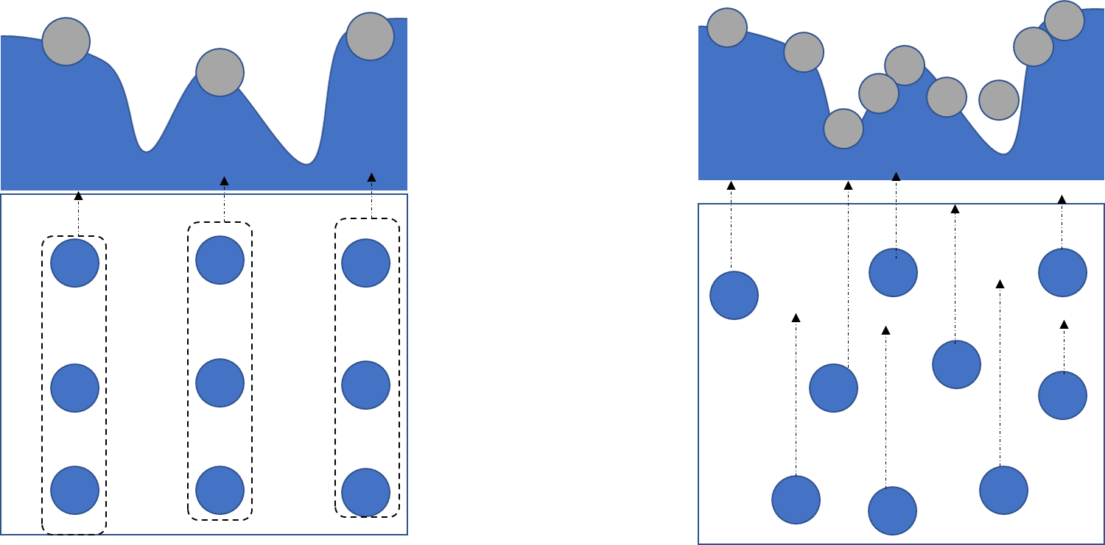
1. Grid Search Vs Random Search Strategy
Grid Search
Random Search
Grid Search
+ Inefficient on Searching in high dimensions space
+ It will find the best hyperparameter, but (computation requirement is expensive)
+ Efficient to explore different possible position in high dimensions space
+ It will not guarantee to find the best hyperparameters
+ Efficient in computation requirements
Random Search

Slide 59
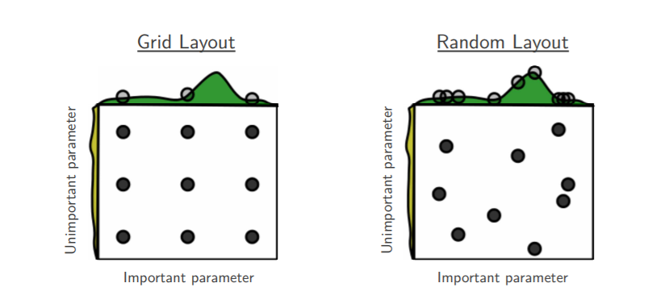
Random Search Strong baseline method
Image source paper
Random Search for Hyper-Parameter Optimization Bergstra and Bengio 2012

Slide 60
Grid and Random Search for NAS
Search Space
Random Search Method
Evaluation Methods
+ Sequential Layers
+ Cell Blocks
+ Branch
Random set a range bounds of Combination hyperparameters
Grid Search Method
Manually set number of possible Combination hyperparameters

Slide 61
Grid and Random Search for NAS
Search Space
Random Search Method
Evaluation Methods
+ Sequential Layers
+ Cell Blocks
+ Branch
Random set a range bounds of Combination hyperparameters
Full Training
Partial Training
Weight-Sharing
Network Morphism
Hypernetworks
Grid Search Method
Manually set number of possible Combination hyperparameters
Further detail in next Part

Slide 62
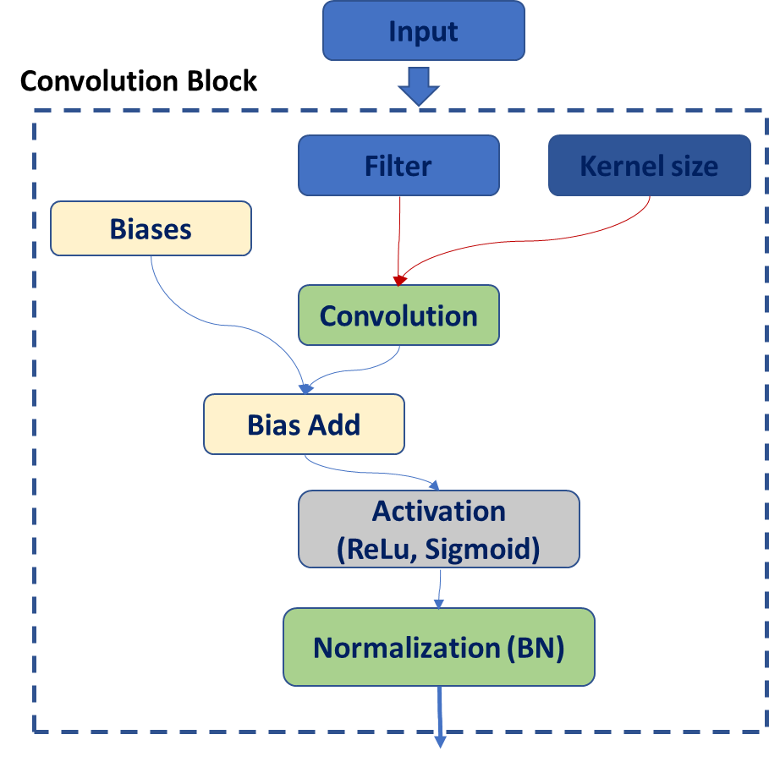
Grid and Random Search for NAS
The example of Basic CNN architecture
Convolution block
Maxpooling
Flatten
Dense
Outputs

Slide 63
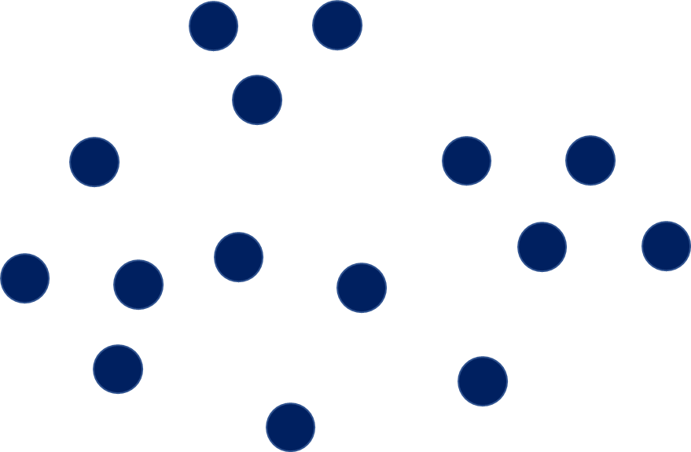

Grid and Random Search for NAS
The searching hyperparameter for Convolution block (filters, kernel size, Activation etc)
Grid Search
Random Search Search

Slide 64

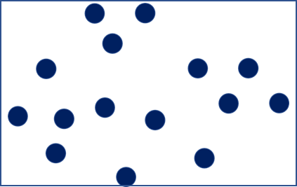
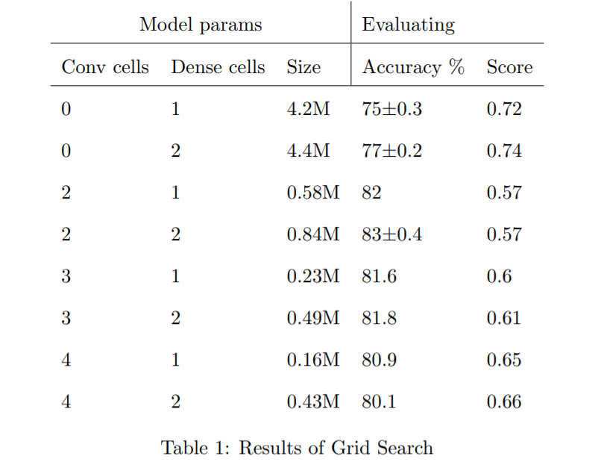
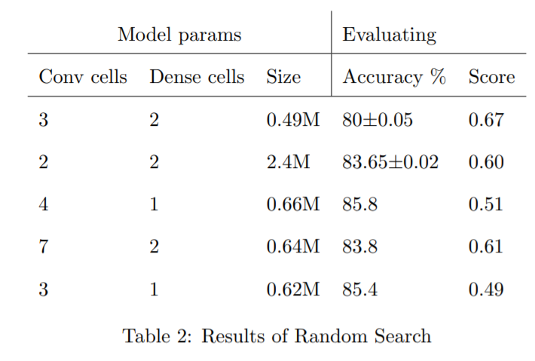
Grid and Random Search for NAS
The example result implements Grid serach and Random search on CIFAR-10 dataset . Liashchynskyi 2019
Grid Search
Random Search Search
Grid Search, Random Search, Genetic Algorithm: A BigComparison for NAS Liashchynskyi 2019

Slide 65
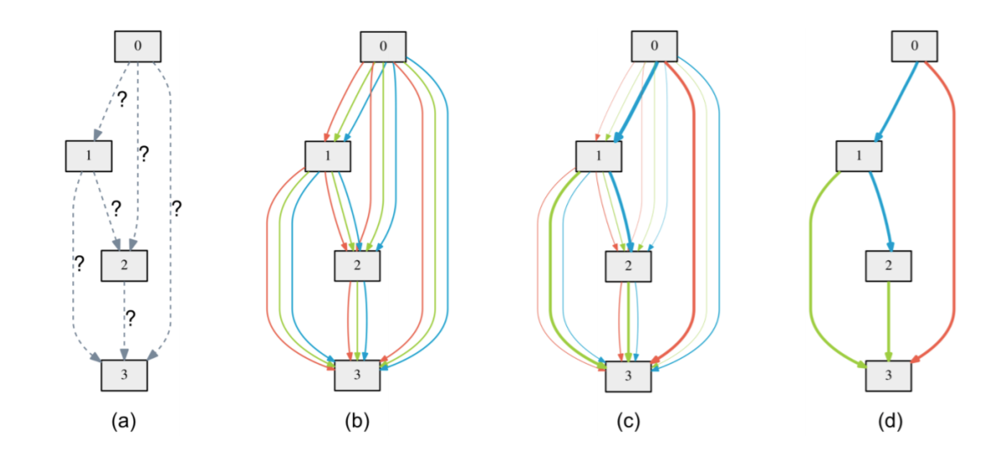
Random Search for NAS base DAG(Directed Acyclic Graph)
Differentiable Architecture Search (DARTS) Liu et al 2019
DAG (Directed acyclic graph. A cell is a DAG consisting of a topologically ordered sequence of N nodes.
+ Each node has a latent representation Xi to be learned. (Gradient Descent- method)
+ Each Edge (i, j, K) is tied to operation type O(i, j, k)

Slide 66
Random Search for NAS base DAG(Directed Acyclic Graph)
Random Search and Reproducibility for Neural Architecture Search Li and Talwalkar 2019
DAG (Directed acyclic graph) – Random Search.
A cell is a DAG consisting of a topologically ordered sequence of N nodes.
+ Each Edge (i, j, K) is tied to operation type O(i, j, k) (Random selected)

Slide 67
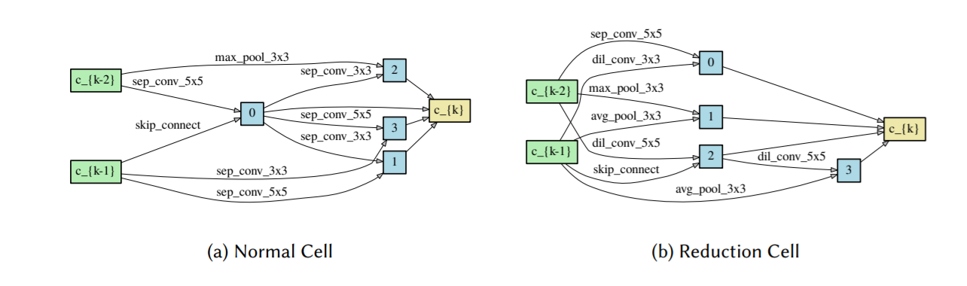
Random Search for NAS computer vision task (CIFAR-10 dataset)
Random Search for NAS base DAG(Directed Acyclic Graph)
Random Search and Reproducibility for Neural Architecture Search Li and Talwalkar 2019

Slide 68
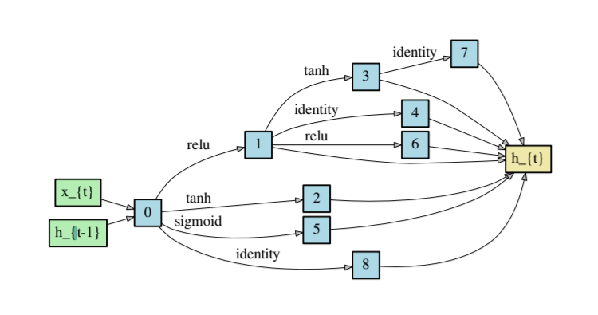
Random Search for NAS base DAG(Directed Acyclic Graph)
Random Search for NAS Result on Language task (PTB dataset)
Recurrent Cell found by random search (Image extract from paper)
Random Search and Reproducibility for Neural Architecture Search Li and Talwalkar 2019

Slide 69
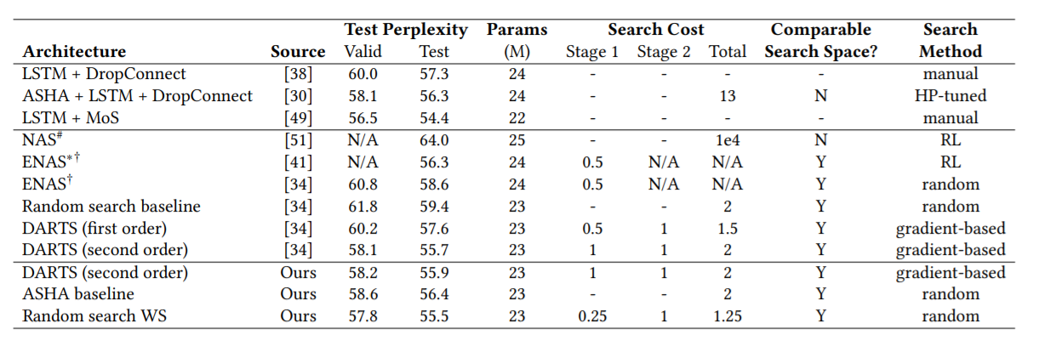
Random Search for NAS
Random Search and Reproducibility for Neural Architecture Search Li and Talwalkar 2019
Hyperparameters Optimization methods Implementation (Link Implementation)

Slide 70
Reinforcement Learning Searching strategy

Slide 71
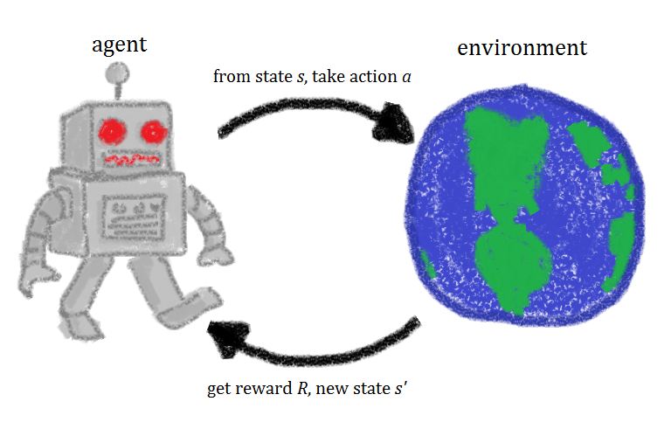
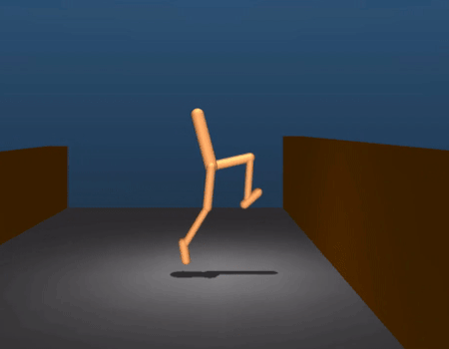
2. Reinforcement Learning
Given a set of rewards or punishments, learn what actions to take next in the future
This image © Zalando Reserach
Image source : https://gfycat.com/

Slide 72
2. Reinforcement Learning
Agent Learning Learner and the decision maker
Environment – where the agent learns and decides what actions to takes
Environment
Actions – Set of actions which the agent can perform
Action
State
Reward
State – the state of the agent in the environment
Agent
Reward – for each action selected by the agent the environment provides a reward
Policy – Decision-making functions(control strategy) of the agent which represent a mapping from situation to actions

Slide 73
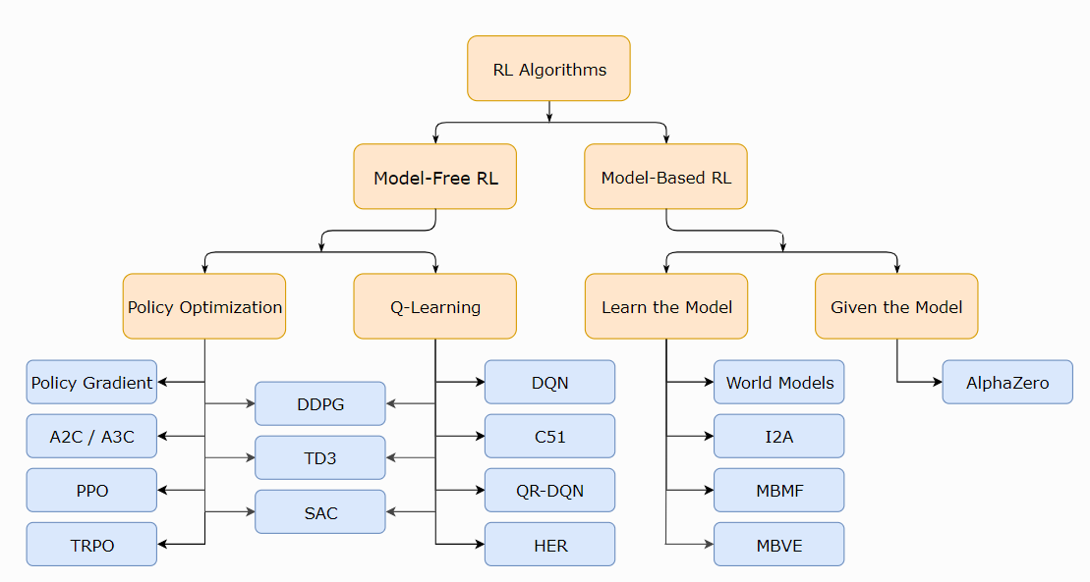
2. Reinforcement Learning Algorithm

Slide 74
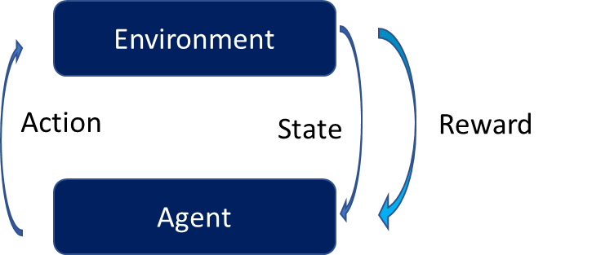
2. Reinforcement Learning Algorithm

Slide 75
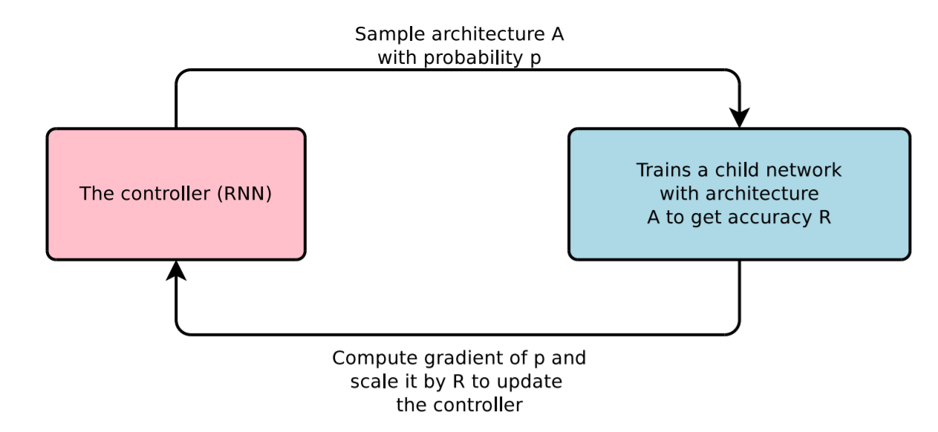
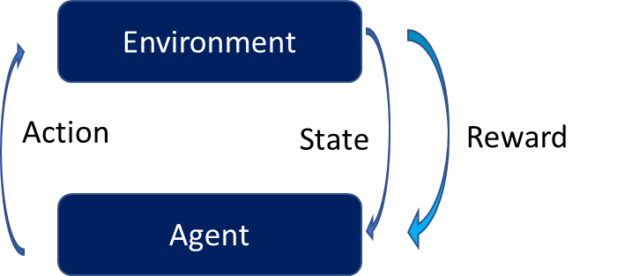
2. Reinforcement Learning Algorithm for NAS
Neural Architecture Search with Reinforcement Learning (Policy Gradient) Zoph & Le ICLR, 2017

Slide 76
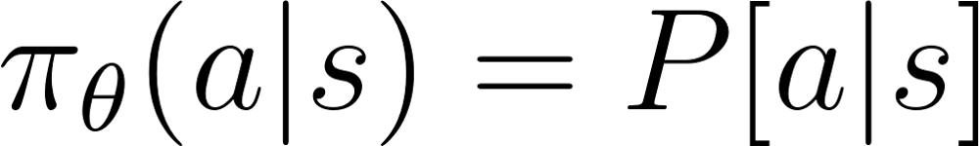
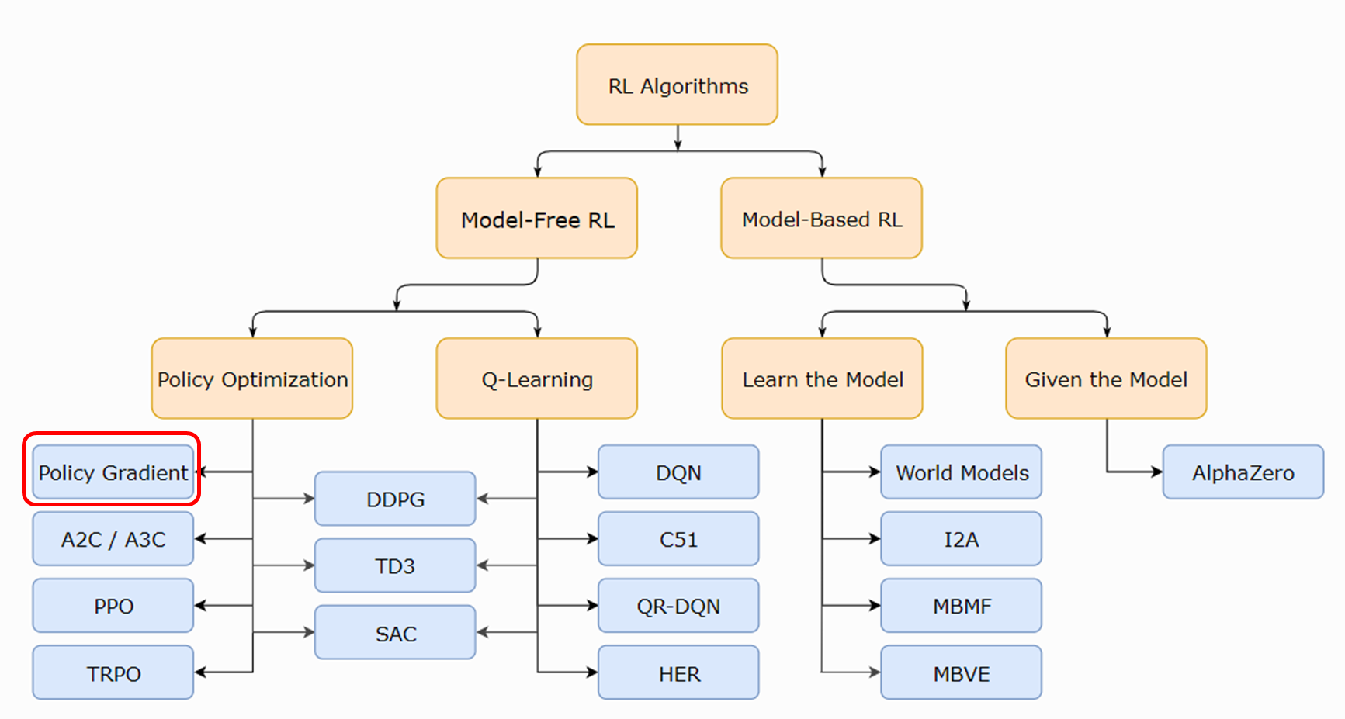
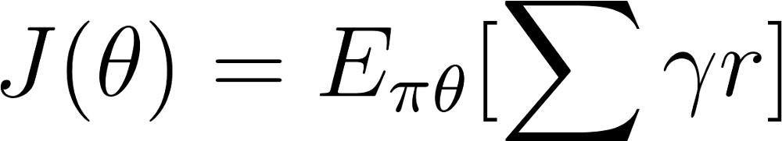
2. Reinforcement Learning Algorithm for NAS
(where γ is in [0,1])
Policy Gradient
π Policy has learnable ϴ parameter → the output is probability distribution of actions
Finding the best learnable ϴ parameter → maximize the score function J(ϴ ) given discount factor γ [0,1] at each instance of time with reward r)

Slide 77
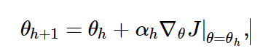
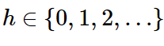
2. Reinforcement Learning Algorithm for NAS
Policy Gradient
π Policy has learnable ϴ parameter → the output is probability distribution of actions
Finding the best learnable ϴ parameter → maximize the score function J(ϴ )
The learnable ϴ update the policy parameterization according to the gradient update rule
Neural Architecture Search with Reinforcement Learning (Policy Gradient) Zoph & Le ICLR, 2017

Slide 78
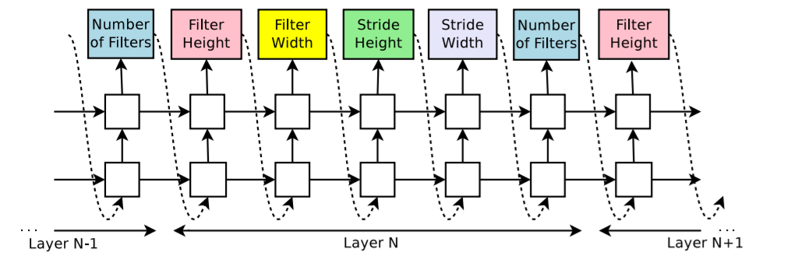
2. Reinforcement Learning Algorithm for NAS
Key Ideas
Controller (RNN-LSTM) -> Generate string that specifies layer-parameters of Network Architecture
Controller
RNN -- LSTM

Slide 79
2. Reinforcement Learning Algorithm for NAS
Key Ideas
Controller (RNN-LSTM) -> Generate string that specifies layer-parameters of Network Architecture
Input
Layer N-2
Layer N-1
Layer N
Layer N+1
….
Outputs
Controller
RNN -- LSTM

Slide 80
2. Reinforcement Learning Algorithm for NAS
Key Ideas
Controller (RNN-LSTM) -> Generate string that specifies layer-parameters of Network Architecture
Input
Layer N-2
Layer N-1
Layer N
Layer N+1
….
Outputs
Controller
RNN -- LSTM

Slide 81
2. Reinforcement Learning Algorithm for NAS
Key Ideas
Controller (RNN-LSTM) -> Generate string that specifies layer-parameters of Network Architecture
Input
Layer N-2
Layer N-1
Layer N
Layer N+1
….
Outputs
1,3,5,7
1,3,5,7
1,2,3
1,2,3
24,36,48,64
Controller
RNN -- LSTM
3
Filter Height
7
Filter Width
1
Stride height
2
Stride width
36
Number of filters

Slide 82
2. Reinforcement Learning Algorithm for NAS
Key Ideas
Controller (RNN-LSTM) -> Generate string that specifies layer-parameters of Network Architecture
Trainer -> Train (“Child Network”) → Evaluate performance of model on validation data set
Input
Layer N-2
Layer N-1
Layer N
Layer N+1
….
Outputs
Sample models A with probability p
1,3,5,7
1,3,5,7
1,2,3
1,2,3
24,36,48,64
Controller
Trainer
RNN -- LSTM
3
Filter Height
7
Filter Width
1
Stride height
2
Stride width
36
Number of filters

Slide 83
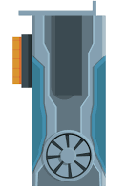
2. Reinforcement Learning Algorithm for NAS
Key Ideas
Controller (RNN-LSTM) -> Generate string that specifies layer-parameters of Network Architecture
Trainer -> Train (“Child Network”) → Evaluate performance of model on validation data set
Input
Layer N-2
Layer N-1
Layer N
Layer N+1
….
Outputs
Sample models A with probability p
1,3,5,7
1,3,5,7
1,2,3
1,2,3
24,36,48,64
Controller
Trainer
RNN -- LSTM
3
Filter Height
7
Filter Width
1
Stride height
2
Stride width
36
Number of filters

Slide 84
2. Reinforcement Learning Algorithm for NAS
Key Ideas
Controller (RNN-LSTM) -> Generate string that specifies layer-parameters of Network Architecture
Trainer -> Train (“Child Network”) → Evaluate performance of model on validation data set
(Policy Gradient) RL update the parameter of the controller base on model child performance
Input
Layer N-2
Layer N-1
Layer N
Layer N+1
….
Outputs
RNN -- LSTM
Sample models A with probability p
1,3,5,7
1,3,5,7
1,2,3
1,2,3
24,36,48,64
Controller
Trainer
Accuracy
Reward
Compute Gradient of P and scale it by R to update the controller
3
Filter Height
7
Filter Width
1
Stride height
2
Stride width
36
Number of filters

Slide 85
2. Reinforcement Learning Algorithm for NAS
Key Ideas
Controller (RNN-LSTM) -> Generate string that specifies layer-parameters of Network Architecture
Trainer -> Train (“Child Network”) → Evaluate performance of model on validation data set
(Policy Gradient) RL update the parameter of the controller base on model child performance
Input
Layer N-2
Layer N-1
Layer N
Layer N+1
….
Outputs
RNN -- LSTM
Sample models A with probability p
1,3,5,7
1,3,5,7
1,2,3
1,2,3
24,36,48,64
Controller
Trainer
Accuracy
Reward
Compute Gradient of P and scale it by R to update the controller
3
Filter Height
7
Filter Width
1
Stride height
2
Stride width
36
Number of filters

Slide 86
2. Reinforcement Learning Algorithm for NAS
RNN -- LSTM
Sample models A with probability p
Controller
Trainer
Iteration N times find the best Architecture
Accuracy
Reward
Compute Gradient of P and scale it by R to update the controller

Slide 87
2. Reinforcement Learning Algorithm for NAS
Sample models A with probability p
RNN -- LSTM
RNN -- LSTM
Sample models A with probability p
Controller
Trainer
Controller
Trainer
Device Platform
Accuracy
Latency
Accuracy
Memory
Reward
Multi-Objective Reward
Compute Gradient of P and scale it by R to update the controller
Compute Gradient of P and scale it by R to update the controller
MnasNet: Platform-Aware Neural Architecture Search for Mobile Tan et al.2019
Neural Architecture Search with Reinforcement Learning Zoph & Le ICLR, 2017

Slide 88
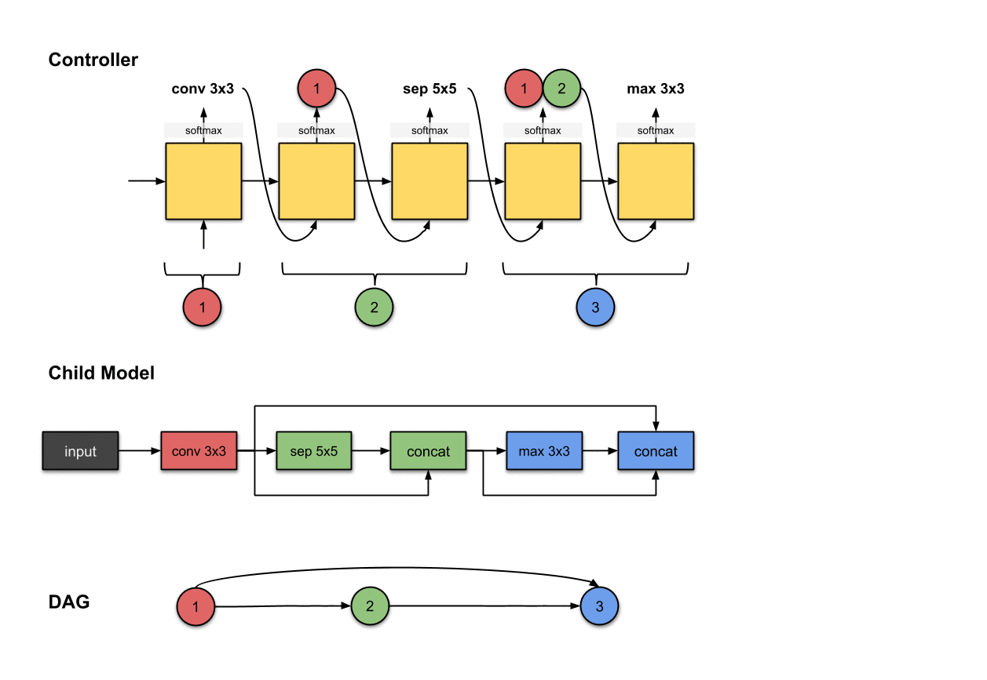
2. Reinforcement Learning Algorithm for NAS
Sequential Layers-Wise
Neural Network Architecture
Image Source: Link access

Slide 89
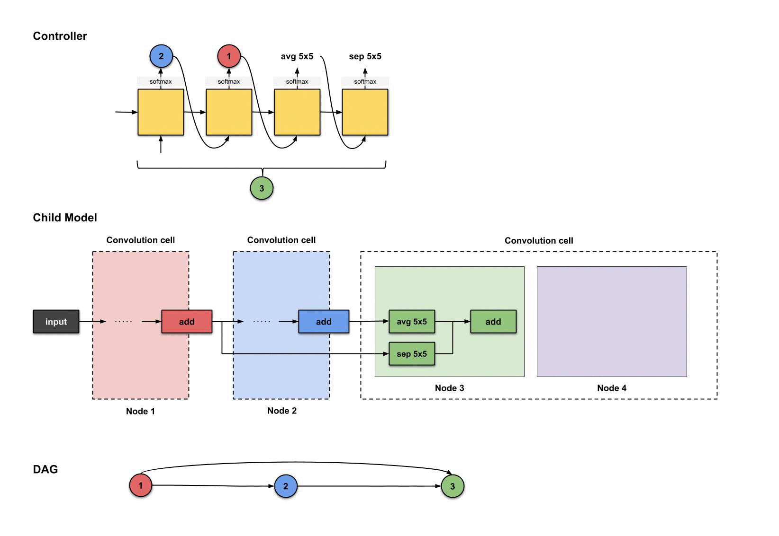
2. Reinforcement Learning Algorithm for NAS
Block -> Cell
Neural Network Architecture

Slide 90
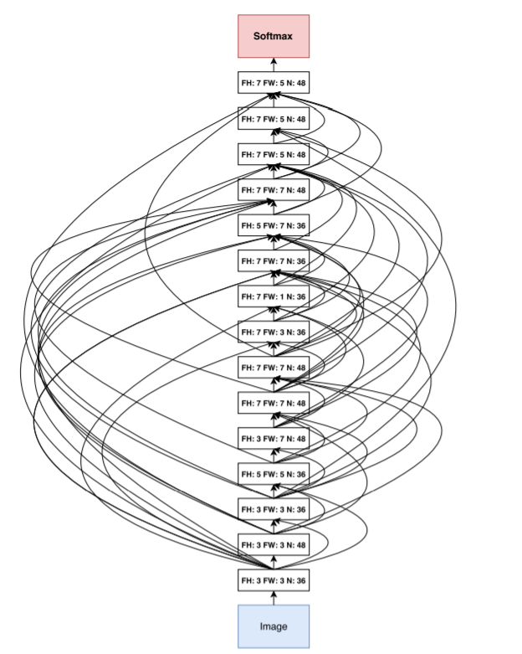
2. Reinforcement Learning Algorithm for NAS
Architecture Discover By Reinforcement Learning
Neural Architecture Search with Reinforcement Learning Zoph & Le ICLR, 2017

Slide 91
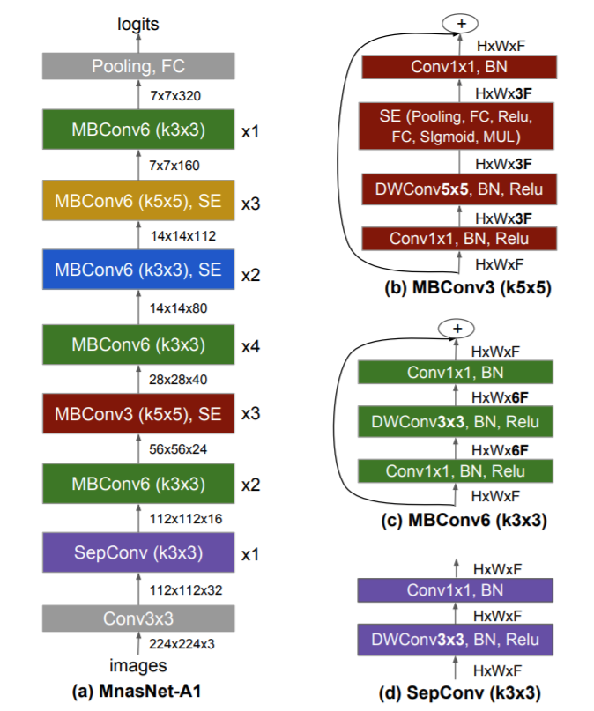
2. Reinforcement Learning Algorithm for NAS
Architecture Discover By Reinforcement Learning
MnasNet: Platform-Aware Neural Architecture Search for Mobile Tan et al.2019

Slide 92

2. Reinforcement Learning Algorithm for NAS
Architecture Discover By Reinforcement Learning
Discovered Cell (LSTM Cell)
Neural Architecture Search with Reinforcement Learning Zoph & Le ICLR, 2017

Slide 93


2. Reinforcement Learning Algorithm for NAS
Language modeling tasks (Treebank dataset)
Image Classification tasks (CIFAR-10 dataset)
Neural Architecture Search with Reinforcement Learning Zoph & Le ICLR, 2017

Slide 94


2. Reinforcement Learning Algorithm for NAS
Accuracy vs. Latency Comparison – ImageNet dataset
Image Object detection tasks– ImageNet dataset
MnasNet: Platform-Aware Neural Architecture Search for Mobile Tan et al.2019

Slide 95
What is the Issue with Reinforcement Learning for NAS??

Slide 96

2. Reinforcement Learning Algorithm for NAS
Computation Bottleneck
800 GPUs –28 days GPUs hours
Neural Architecture Search with Reinforcement Learning Zoph & Le ICLR, 2017

Slide 97
ENAS Efficient Reinforcement Design for NAS
https://smartlabai.medium.com/introduction-to-neural-architecture-search-reinforcement-learning-approach-55604772f173

Slide 98

ENAS weight Parameter sharing Grate Improvement

Slide 99

ENAS searching Result

Slide 100
Edit Slides for ENAS

Slide 101
Evolutionary Searching strategy

Slide 102

3. Evolutionary Searching Algorithm
Image- public domain
Link Access

Slide 103
3. Evolutionary Searching Algorithm
Terminology – Evolutionary Algorithm
1. One or more populations of individuals competing for limited resources.
2. The notion of dynamically changing populations due to the birth and death of individuals.
3. A concept of fitness which reflects the ability of an individual to survive and reproduce.
4 A concept of variational inheritance: Offspring closely resemble their parents, but not identical.
Evolutionary Computation: Unified Approach Keenneth A. De Jong

Slide 104

3. Evolutionary Searching Algorithm
Evolutionary Algorithm Search attempt to match word using random mutations and the fitness function (image source)

Slide 105
3. Evolutionary Searching Algorithm
Randomly generate the initial population of M individuals
(using a uniform probability distribution over the entire geno/phenospace)
Do Forever:
1. Choose a parent as follows:
- Select a parent randomly using a Uniform probability distribution over the current population
2. Use the selected parent to produce a single offspring by
- Making an identical copy of the parent, and then probabilistically Mutating it to produce the offspring
3. Compute the fitness of the offspring
4. Select a member of the population to die by
- Randomly selecting from the current population using a uniform probability distribute candidate for removing and keeping either the candidate or the offspring depending on which one has higher fitness.
End Do
Evolutionary Computation: Unified Approach Keenneth A. De Jong

Slide 106
3. Evolutionary Search Algorithm
1: Randomly generate the initial population of M individuals
Population
Initialization
A Survey on Neural Architecture Search Wistuba et al 2019

Slide 107
3. Evolutionary Search Algorithm
1: Randomly generate the initial population of M individuals
2: Select Parents from the population for reproduction
Tournament selection(Goldberg and Deb,1990)
Parents
Parent Selection
Initialization
Population
A Survey on Neural Architecture Search Wistuba et al 2019

Slide 108
3. Evolutionary Search Algorithm
1: Randomly generate the initial population of M individuals
2: Select Parents from the population for reproduction
Tournament selection(Goldberg and Deb,1990)
Parents
Parent Selection
Initialization
Population
Recombination
& Mutation
Offspring
A Survey on Neural Architecture Search Wistuba et al 2019

Slide 109
3. Evolutionary Search Algorithm
1: Randomly generate the initial population of M individuals
2: Select Parents from the population for reproduction
Tournament selection(Goldberg and Deb,1990)
Parents
Parent Selection
Initialization
Population
Recombination
& Mutation
3: Mutations:
+ Add layers
+ Remove layers
+ Change number filters in Conv Layer
+Add skip connection
Offspring
A Survey on Neural Architecture Search Wistuba et al 2019

Slide 110

Evolutionary Search Algorithm
+ Step2: Example of recombination and mutation operations to create Childs networks in practice.
Parents
Parent Selection
hidden state mutation -> Random choose pairwise combination & rewires a random.
Population
Survivor Selection
Recombination
& Mutation
Offspring
Fitness Evaluation
Operation state mutation -> Random replaces an existing with a random one.
Aging Evolution for Image Classifier Architecture Search Real et al.2018

Slide 111
Evolutionary Search Algorithm
+ Step2: Apply recombination and mutation operations to create Childs networks
Mutations:
+ Add layers
+ Remove layers
+ Change number filters in Conv Layer
+Add skip connection
Parents
Parent Selection
Population
Survivor Selection
Recombination
& Mutation
Offspring
Fitness Evaluation

Slide 112
3. Evolutionary Search Algorithm
1: Randomly generate the initial population of M individuals
2: Select Parents from the population for reproduction
Tournament selection(Goldberg and Deb,1990)
Parents
Parent Selection
Initialization
Population
Recombination
& Mutation
Offspring
Fitness Evaluation
A Survey on Neural Architecture Search Wistuba et al 2019

Slide 113
3. Evolutionary Search Algorithm
1: Randomly generate the initial population of M individuals
2: Select Parents from the population for reproduction
Tournament selection(Goldberg and Deb,1990)
Parents
Parent Selection
Initialization
Population
Recombination
& Mutation
Survivor Selection
Offspring
Fitness Evaluation
A Survey on Neural Architecture Search Wistuba et al 2019

Slide 114

3. Evolutionary Searching Algorithm
Population: group of individuals.
Generation: a reset of the population.
Individuals (= chromosomes): one possible solution to the problem
Design parameters (= genes): the parameters to optimise. Each individual is defined by a list of its design parameters.
Objective function (= fitness function): the function to minimise.
Design space: set of all the possible design parameters values.
Objective space: set of all the objective function value.
Parents: individuals belonging to an older generation.
Offspring: individual belonging to a younger generation.
Crossover: it consists in combining the genes of two parents to create an offspring
Mutation: it consists in altering a few genes of a parent to create an offspring.
Genetic algorithm 2 design parameters (x, y). The objective is to minimize the function Z(x, y) = x.sin(x)*y.cos(y).

Slide 115

3. Evolutionary Searching Algorithm
The evolution of a network Each color represents a different type of architecture block. The final network is formed via mutations of high performing candidate networks, in this case adding depth. (image Link)

Slide 116


Slide 117


Slide 118

Evolutionary Search Algorithm
+ Step3: Evaluate the fitness of the new individuals
Parents
Parent Selection
Population
Survivor Selection
Offspring
Evaluate Performance (Metrics)
Fitness Evaluation

Slide 119


Slide 120




Evolutionary Search Algorithm
+ Step4: Select the survivors of the population
Total population increased
Parents
Parent Selection
Time
Population
Survivor Selection
=> Different Policy to select the network
Tournament selection
+ fitness prop
+ elitist
+ Youngest
+ all
Offspring
Fitness Evaluation

Slide 121

Evolutionary Search Algorithm dataset and paper name explain Tournament selection
Tournament selection
+ fitness prop
+ elitist
+ Youngest
+ all
Large-Scale Evolution of Image Classifiers Real et al.2017

Slide 122


A Survey on Evolutionary Neural Architecture Search Liu et al. 2021
Applications of Existing Enas Algorithms.

Slide 123

Image Source : Link access

Slide 124

Regularized Evolution for Image Classifier Architecture Search Real et al. 2019
Figure : Architectures of overall model and cells. From left to right: outline of the overall model [54] and diagrams for the cell architectures discovered by evolution: AmoebaNet-B, AmoebaNet-C, and AmoebaNet-D. The three normal cells are on the top row and the three reduction cells are on the bottom row

Slide 125

Evolutionary computation Requirment

Slide 126

Comparing benchmark (Random Search – Reinforcement learning – Evolutionary so search method

Slide 127
Working and Evaluating with all Candidates in my Search spaces Define Above

Slide 128


Slide 129
Bayesian Optimization

Slide 130
Bayesian Optimization
Terminology
Bayesian Optimization is sequential model-base optimization -> The result from the previous iterations to decide the next hyperparameter values candidate.
-> Instead Blindly searching the hyperparameter in search space like (Random Search, Grid Search)-> This method use prior knowledge to pick the next set hyperparameter values, which will improve the model performance.
-> Iteratively repeat this process until we reach optimal value.

Slide 131
Bayesian Optimization Concept
Probabilistic Model
Search Space

Slide 132
Bayesian Optimization Concept
Probabilistic Model
Probabilistic Model
Probabilistic Model
Search Space
Probabilistic Model

Slide 133
Bayesian Optimization Concept
Probabilistic Model
Probabilistic Model
Observer model
Performance
Probabilistic Model
Search Space
Probabilistic Model

Slide 134
Bayesian Optimization Concept
Probabilistic Model
Best Model performance
Probabilistic Model
Performance
Observer model
Probabilistic Model
Search Space
Updated model
Probabilistic Model

Slide 135
Bayesian Optimization Concept
Best Model performance
Probabilistic Model
Performance
Search Space
Updated model

Slide 136
Bayesian Optimization Concept
Suggested next set Hyperparameters
Probabilistic Model
Performance
Search Space
Updated model

Slide 137
Bayesian Optimization Concept
Suggested next set Hyperparameters
Observer model
Probabilistic Model
Performance
Search Space
Updated model

Slide 138
Bayesian Optimization Concept
Global maximized/minimized
Suggested next set Hyperparameters
Observer model
Probabilistic Model
Performance
Optimal objective function model
Search Space
Updated model

Slide 139
Bayesian for Hyperparameter Optimization
1. Initial select set of combination hypermeter values (Our belief) and Training the model with it
Get the evidence (Model accuracy)
Update our belief that can lead to model improvement
Terminate when a Our criteria goals is met (Loss values is reached global minimize, Accuracy is global maximized)

Slide 140
(Independence - Dependent) Probability
Independence Probability: the knowledge that one event occurs does not affect the probability of the other event
P(a ∧ b) = P(a) P(b)
Dependent Probability (Conditional probability): the knowledge that one event occurs does affect the probability of the other event
P(a ∧ b) = P(a) P(b|a)

Slide 141



Probability (Independence - Dependent)
Independence Probability: the knowledge that one event occurs does not affect the probability of the other event
P(a ∧ b) = P(a) P(b|a)
P( )
P( )

Slide 142
Probability (Independence - Dependent)
Independence Probability: the knowledge that one event occurs does not affect the probability of the other event
P(a ∧ b) = P(a) P(b|a)
P(a ∧ b) = P(a)P(b)
P(a ∧ b ) = P( ) P( )
P( )
P( )

Slide 143
Probability (Independence - Dependent)
Independence Probability: the knowledge that one event occurs does not affect the probability of the other event
P(a ∧ b) = P(a) P(b|a)
P(a ∧ b) = P(a)P(b)
P(a ∧ b ) = P( ) P( )
P( )
P( )
P(a ∧ b ) = P( 1/6 ) * P( 1/6 )

Slide 144

Probability (Independence - Dependent)
Dependent Probability: the knowledge that previous event occurs does affect the probability of the other event
P(a ∧ b) = P(a) P(b|a)
Morning
Afternoon
P( )
P( )

Slide 145
Bayes’ Theorem
P(a ∧ b) = P(b) P(a|b)
P(a ∧ b) = P(a) P(b|a)
Good explanation concept for Bayes’ theorem

Slide 146
Bayes’ Theorem
P(a | b) = P(a) P(b | a)
P(b)
posterior
prior
likelihood
marginal likelihood

Slide 147
Bayes’ Theorem
Given clouds in the morning, what's the probability of rain in the afternoon?

Slide 148
Bayes’ Theorem
Given clouds in the morning, what's the probability of rain in the afternoon?
40% of days have cloudy mornings (Initial Hypothesis)
10% of days have rainy afternoons (Prior probability, hypothesis is True)
(Evidence)
70 % of rainy afternoons start with cloudy mornings (Evidence, hypothesis is True)

Slide 149
Bayes’ Theorem
Given clouds in the morning, what's the probability of rain in the afternoon?
P(a | b ) = P( ) P( b | a )
P( b )
40% of days have cloudy mornings (Initial Hypothesis)
10% of days have rainy afternoons
P(a | b ) = 0.1 * 0.7
0.4
(Evidence)
70 % of rainy afternoons start with cloudy mornings

Slide 150

We Try to Apply Bayes’ Theorem Hyperparameter Optimization
P(metric|$\text{hyperparameter} \text{combination}$)=P($\text{hyperparameter} \text{combination}$|$\text{metric}$)P($\text{metric}$)
P($\text{hyperparameter} \text{combination}$ )

Slide 151

We Try to Apply Bayes’ Theorem Hyperparameter Optimization
P(metric|$\text{hyperparameter} \text{combination}$) = P($\text{hyperparameter} \text{combination}$ | $\text{metric}$) P($\text{metric}$)
P($\text{hyperparameter} \text{combination}$ )
is the probability of given metric to be minimized/maximized given the combination of hyperparameter.

Slide 152
We Try to Apply Bayes’ Theorem Hyperparameter Optimization
P(metric|$\text{hyperparameter} \text{combination}$) = P($\text{hyperparameter} \text{combination}$ | $\text{metric}$) P($\text{metric}$)
P($\text{hyperparameter} \text{combination}$ )
is the probability of given metric to be minimized/maximized given the combination of hyperparameter.
is the probability of a certain hyperparameter combination IF the given metric is minimized/maximized.

Slide 153
We Try to Apply Bayes’ Theorem Hyperparameter Optimization
P(metric|$\text{hyperparameter} \text{combination}$) = P($\text{hyperparameter} \text{combination}$ | $\text{metric}$) P($\text{metric}$)
P($\text{hyperparameter} \text{combination}$ )
is the probability of given metric to be minimized/maximized given the combination of hyperparameter.
is the probability of a certain hyperparameter combination IF the given metric is minimized/maximized.
is The initial metric quantity.

Slide 154
We Try to Apply Bayes’ Theorem Hyperparameter Optimization
P(metric|$\text{hyperparameter} \text{combination}$) = P($\text{hyperparameter} \text{combination}$ | $\text{metric}$) P($\text{metric}$)
P($\text{hyperparameter} \text{combination}$ )
is the probability of given metric to be minimized/maximized given the combination of hyperparameter.
is the probability of a certain hyperparameter combination IF the given metric is minimized/maximized.
is The initial metric quantity.
is the probability of getting that particular hyperparameter combination

Slide 155

Bayesian optimization
Bayesian hyperparameter Optimization is building the probabilistic model P(metric | hyperparameter combination) is referred to a surrogate model trying to minimize/maximize for the objective function f() with x is the design search space of interest (categorical or condition inputs)
➔ we want to find the set hyperparameters that yield the best score on the validation set metric

Slide 156
Bayesian optimization
1. Building the Surrogate probability P(metric | hyperparameters) model of the objective function
2. Finding the Hyperparameters that perform best on the surrogate
3. Apply these Hyperparameters to the true objectives function (Train and evaluate)
4. Update model (update belief) incorporating the new results
5 Repeat step 2- > 4 until max iterations or time is reached

Slide 157

The Example Using Bayesian Optimization
Implementation Bayesian Optimization to set hyperparameter to match to the ground truth function.
Noticed, in practice optimization hyperparameter, this function is unknown, the only information we have is obtained by sequentially probing it at different points.
The example Ground-Truth Function the

Slide 158

Bayesian Optimization the Target function
Sequential Model-Base Optimization (SMBO)
Search Space
An objective function takes (hyperparameters) outputs a score to minimize/ maximize.
The surrogate model of the objective function
Utility selection function, for evaluating which hyperparameters to choose next from the surrogate model
A history consisting of (score, hyperparameter) pairs used by the algorithm to update the surrogate model
Implementation Bayesian optimization GitHub code

Slide 159
Bayesian Optimization the Target function
Different option for building Surrogate model (probabilistic models )
Gaussian Process Regression (Detail)
Random Forest Regression
Tree-structured Parzen Estimator
Implementation Bayesian optimization GitHub code

Slide 160


Bayesian Optimization Gaussian Process 2 Steps
The estimate surrogate model in – black line associated with The uncertainty Blue areas defined by standard deviation & mean.
➔ Surrogate model is poorly approximation of the actual objective function in blue line

Slide 161
Bayesian Optimization Gaussian Process 2 Steps
What is the next to set Hyperparameters ?
-> GP gives us easy closed-from marginal means and variances
+ predictive mean function μ(x)
+ predictive variance function σ²(x)

Slide 162



Bayesian Optimization Gaussian Process 3 Steps
+ Exploration: Seek places with high variance
+ Exploitation: Seek place with low mean
‣ The Utility function balances these for our proxy optimization to determine the next evaluation
‣ GP Upper Confidence Bound (Srinivas et al. 2010):
Other implementation Utility Function EI (Expected improvement (Mockus 1978)

Slide 163

Bayesian Optimization Gaussian Process 4 Steps

Slide 164

Bayesian Optimization Gaussian Process 5 Steps

Slide 165

Bayesian Optimization Gaussian Process 6 Steps

Slide 166

Bayesian Optimization Gaussian Process 7 Steps

Slide 167

Bayesian Optimization Gaussian Process 8 Steps

Slide 168

Bayesian Optimization Gaussian Process 9 Steps

Slide 169



Comparison Bayesian Optimization vs Grid and Random Search
Grid Search
Random Search
Bayesian Optimization
Image source: Link access

Slide 170

Bayesian optimization for NAS
Sequential Model-Base Optimization (SMBO)
Search Space
An objective function takes (hyperparameters) outputs a score to minimize/ maximize.
The surrogate model of the objective function
Utility selection function, for evaluating which hyperparameters to choose next from the surrogate model
A history consisting of (score, hyperparameter) pairs used by the algorithm to update the surrogate model
NAS-Sequential model-based optimization PNAS Liu et al 2018

Slide 171
Bayesian optimization for NAS
Block Cell Type 1
Normal Cells:
Preserves the Spatial Inputs Resolution
Block Cell Type 2
Reduction Cells:
Reduce the Spatial Inputs Resolution

Slide 172

Bayesian optimization for NAS
Block 1
Block 2
Starting with 1 Block cells

Slide 173
Bayesian optimization for NAS
Block 1
Block 256
Training all 1-Block Cells – There are only 256 of them.!!
Starting with 1 Block cells

Slide 174

Bayesian optimization for NAS
K most promising
Predicter [ Probabilistic model (PG- Surrogate Models) ]
Training all 1-Block Cells – There are only 256 of them.!!
0
Starting with 1 Block cells

Slide 175

Bayesian optimization for NAS
K most promising
Suggest promising blocks
Choosing the K most promising block expand into 2-Block cells
+ Train predictor (PG- Surrogate Models)
+ Training all 1-Block Cells – There are only 256 of them.!!
Starting with 1 Block cells

Slide 176

Bayesian optimization for NAS
K most promising
Choosing the K most promising blocks
Train predictor (PG- Surrogate Models)
Training all 1-Block Cells – There are only 256 of them.!!
Starting with 1 Block cells

Slide 177

Bayesian optimization for NAS
Could we Train All 2-block cells ??
→ Choosing Promising Blocks
For a reasonable K, too many 2-block candidates to train. It is really “expensive” to obtain the performance, Each one takes hours of training and evaluating on Large dataset.
➔ Maybe can afford 10^2 , but definitely cannot afford 10^5

Slide 178

Bayesian optimization for NAS
K most promising
Suggest promising blocks
→ Predictor apply predictor to select top K
+ Choosing the K most promising blocks expand into 2-Block cells
+ Train predictor (PG- Surrogate Models)
+ Training all 1-Block Cells – There are only 256 of them.!!

Slide 179

Bayesian optimization for NAS
Train Selected Top K blocks model
+ Predictor apply predictor to select top K
+ Choosing the K most promising Cells expand into 2-Block cells
+Train predictor (PG- Surrogate Models)
Training all 1-Block Cells – There are only 256 of them.!!

Slide 180

Bayesian optimization for NAS
Update the Surrogate Model
+ Estimate the Selected Top K block
+ Predictor apply predictor to select top K
+ Choosing the K most promising Cells expand into 2-Block cells
+ Train predictor (PG- Surrogate Models)
+ Training all 1-Block Cells – There are only 256 of them.!!

Slide 181

Bayesian optimization for NAS
-> Expand promising 3-block cells
+ Update the Surrogate Model
+ Estimate the Selected Top K block
+ Predictor apply predictor to select top K
+ Choosing the K most promising expand into 2-Block cells
Train predictor (PG- Surrogate Models)
Training all 1-Block Cells – There are only 256 of them.!!

Slide 182

Bayesian optimization for NAS
→ Predictor predict to select top K
+ Expand promising 3-block cells
+ Update the Surrogate Model
+ Estimate the Selected Top K block
+ Predictor apply predictor to select top K
+ Choosing the K most promising Cells expand into 2-Block cells
+ Train predictor (PG- Surrogate Models)
+ Training all 1-Block Cells – There are only 256 of them.!!

Slide 183

Bayesian optimization for NAS
NAS-Sequential model-based optimization PNAS Liu et al 2018

Slide 184

Bayesian optimization for NAS
NAS-Sequential model-based optimization PNAS Liu et al 2018

Slide 185

Bayesian optimization for NAS
NAS-Sequential model-based optimization PNAS Liu et al 2018

Slide 186

Bayesian optimization for NAS
BANANAS: Bayesian Optimization with Neural Architectures for Neural Architecture Search implementation

Slide 187

Bayesian optimization for NAS
INTERPRETABLE NEURAL ARCHITECTURE SEARCH VIA BAYESIAN OPTIMISATION WITH WEISFEILERLEHMAN KERNEL
pdf (openreview.net)

Slide 188


Bayesian optimization Hyperparameter In Practice
“During the development of AlphaGo, its many hyperparameters were tuned with Bayesian optimization multiple times,
this automatic tuning process resulted in substantial improvements in playing strength.
For example, prior to the match with Lee Sedol, we tuned the latest AlphaGo agent and this improved its win-rate from 50% to 66.5% in self-play games. This tuned version was deployed in the final match”
Extract from Hutter & Vanschoren: AutoML slide

Slide 189
Evolutionary
Reinforcement Learning
Bayesian Optimization

Slide 190

Neural Architecture Search: Coming Of Age Frank Hutter

Slide 191
During the development of AlphaGo, its many hyperparameters were tuned with Bayesian optimization multiple times
This automatic tuning process resulted in substantial improvements in playing strength. For example, prior to the match with Lee Sedol, we tuned the latest AlphaGo agent and this improved its win-rate from 50% to 66.5% in self-play games. This tuned version was deployed in the final match
Implementation Python Bayesian optimization from scratch Jason Brownlee 2019
Fitune your hyperparameter model weight and bias colab implementation

Slide 192
NAS– Evaluation Strategy
Training From Scratch
Partially Training
Proxy Task Performance
Parameter weight sharing
Prediction-Based
Others

Slide 193
Training From Scratch
Error
Testing Error
Training Error
Number Epochs

Slide 194
Error
Training all Model found in search Space
Model 1
Model 2
Model 3
….
Model N
Testing Error
Training Error
Adding Paper References
Number Epochs
What is the problem with this evaluate method ??
1
2
3
…..
N
Zoph & Le 2017
Neural Architecture Search with Reinforcement Learning
800 K40 GPUs for 28 days

Slide 195
2. Partial Training
Error
Model Best Performance
Testing Error
Training Error
Early stop
Number Epochs

Slide 196
2. Partial Training
Error
Adding Paper References
Training all Model found in search Space
Model 1
Model 2
Model 3
….
Model N
Testing Error
Training Error
Early stop
Number Epochs

Slide 197
Evaluate Model Search Proxy Task Performance
There are several approaches for using a proxy task performance as the performance estimator of a child network, which is generally cheaper and faster to calculate:
Train on a smaller dataset.
Train for fewer epochs.
Predict the learning curve. Baker et al (2018) model the prediction of validation accuracies as a time-series regression problem.

Slide 198



Model Evaluate Training on a few Epochs
Evaluate Model Search Proxy Task Performance

Slide 199

Adding Paper References

Slide 200
Showing improvemtn

Slide 201

Parameter weight sharing
Set Connections (Parameters) of Neuron in Neural Network architecture

Slide 202

Set Neurons Weights of Neuron in Neural Network architecture

Slide 203

Adding New Layer
First Neural Network Architecture
Newer Neural Network Architecture
Architecture now is adding one more layers Do we need to Pretrain model again?

Slide 204
Same Layers
New Adding Layers

Slide 205

Sharing the same weights

Slide 206
Sharing the same weights
Train update weights for new layers

Slide 207

Efficient NAS via Parameters Sharing Pham et al.2018
The Core idea of ENAS the sample architecture graphs can be view as sub-graphs for Larger super graph.

Slide 208

Image Source from A Comprehensive Survey of Neural Architecture Search: Challenges and Solutions Ren et al.2021

Slide 209
Image Source from A Comprehensive Survey of Neural Architecture Search: Challenges and Solutions Ren et al.2021
Efficient NAS via Parameters Sharing Pham et al.2018
+ The Core idea of ENAS the sample architecture graphs can be view as sub-graphs for Larger super-graph. All sub-graph are weights sharing of the Super-graph.
+ The red connections are active and update weight during training.

Slide 210

This table extracts from paper
Efficient NAS via Parameters Sharing Pham et al.2018

Slide 211
Weight Prediction Based
First Model
Gradient Descent for Update weights of new architecture (backpropagation)
Forward path
Backward path
New Generated Model

Slide 212
Weight Prediction Based
First Model
Prediction sets of weights?
New Generated Model

Slide 213
Prediction sets of weights?
Using HyperNet to directly generate the weights of the model (Ha et al.2016)
SMASH: One-Shot Model Architecture Search Through Hypernetworks (Broket et al.2017)
+ Using Hypernet-generated weights is validated directly → No need training child's models → But need to train and update HyperNet

Slide 214


Using Hypernet to directly generate the weights of the model (Ha et al.2016)
Feed forward network, no weight sharing (top). Recurrent network, weight sharing (bottom).

Slide 215



Slide 216



Slide 217


Using Hypernet to directly generate the weights of the model (Ha et al.2016)

Slide 218

Using Hypernet to directly generate the weights of the model (Ha et al.2016)
(Image source extracted: Brock et al. 2017)
SMASH algorithm (a) model evaluate with predicted weight, (b) Hypernet should large enough capability otherwise will be corrupted if too small to child’s model

Slide 219
SMASH can be viewed as another way to implement the idea of parameter sharing. One problem of SMASH as pointed out by Pham et al. (2018) is: The usage of HyperNet restricts the weights of SMASH child models to a low-rank space, because weights are generated via tensor products. In comparison, ENAS has no such restrictions.

Slide 220
3.
Efficient NAS Techniques & NAS Benchmark

Slide 221

https://media.neurips.cc/Conferences/NIPS2018/Slides/hutter-vanschoren-part1-2.pdf

Slide 222
Weight Inheritance and Network Morphism
weight sharing & One-shot models
Meta-Learning

Slide 223

Weight Inheritance and Network Morphism
Image_sources: Link access

Slide 224

Weight Inheritance and Network Morphism
Image_sources: Link access

Slide 225
Efficient NAS with Network Morphism
+ Change the network structure, but not the modelled function (for every inputs the network yields the same outputs as before applying the network morphism
Using network morphism in NAS algorithms as operations to generate new networks avoid cost of training all model layers from Scratch

Slide 226
Efficient NAS with Network Morphism
Network morphisms
We have trained a network N1(x) = Softmax(w1,1)* ReLU * Conv(w1,2) (x)
Want to add another Relu-Conv Block
N2(x) = Softmax(w2,1) * ReLU * Conv(w2,2) * ReLU * Conv(w2,3) (x)
Our Goals Is initialize the weight N2(x) = N1(x) for every X
+ Step 1 Copy weights of unchanged parts of network W2,1= W1,1; W2,3= W1,2
+ Step 2 Initialize new conv layer to be identity mapping Conv W(2,2) (x) = x
Then
N2(x) = Softmax(w2,1) * ReLU * Conv(w2,2) * ReLU * Conv(w2,3) (x)
=Softmax(w1,1)* ReLU * Conv(w2,2) * ReLU * Conv(w1,2) (x) // Copy Weights

Slide 227
Efficient NAS with Network Morphism
The function ApplyNetMorphs from our algorithm uniformly samples one of the three actions: • Make the network deeper, i.e., add a ”Conv-BatchNorm-Relu” block. The position where to add the block, as well as the kernel size (∈ {3, 5}), are uniformly sampled. The number of channels is chosen to be equal to he number of channels of the closest preceding convolution. • Make the network wider, i.e., increase the number of channels by using the network morphism type II. The conv layer to be widened, as well as the widening factor (∈ {2, 4}) are sampled uniformly at random. • Add a skip connection from layer i to layer j (either by concatenation or addition – uniformly sampled) by using network morphism type II or IV, respectively. Layers i and j are also sampled uniformly

Slide 228

One Short NAS

Slide 229

Building Block for each model Graph

Slide 230


Slide 231
The issue of Bender et al 2018 one shot model
It contains every possible operation in search space, with scheduleDropPath(the dropout rate is increased over time, which is r1/k at the end of training, where 0<r<1 is hyperparam and k is the number if incoming paths.
+ one shot model created by random zeroing out or removing some operations. This sampling process can be replace (RL and EV)
What is the issue of current One shot method

Slide 232

Small Fine-tuning could be very large impact on model performance

Slide 233

Small Fine-tuning could be very large impact on model performance
+ When zeroing out and removing useful operations lead to big reduction in Model accuracy,
+ and when remove some less important components only causes a small impact/
Instead Removing zeroing out to create model we can use Gradient Descent optimize.
DARTS Liu et al.2019 (Jointly train architecture parameters and weights via gradient descent)

Slide 234
Differentiable Architecture Search (DARTS)
DAG (Directed acyclic graph. A cell is a DAG consisting of a topologically ordered sequence of N nodes.
+ Each node has a latent representation Xi to be leared.
+ Each Edge (i, j) is tied to some operation O(i, j)

Slide 235


Slide 236


Slide 237


Slide 238


Slide 239


Slide 240


Slide 241
DARTS is able to greatly reduce the cost of GPU hours. Their experiments for searching for CNN cells have N=7 and only took 1.5 days with a single GPU. However, it suffers from the high GPU memory consumption issue due to its continuous representation of network architecture. In order to fit the model into the memory of a single GPU, they picked a small N

Slide 242

Proxyless NAS – Once For All
To constrain the GPU memory consumption, ProxylessNAS (Cai et al., 2019) views NAS as a path-level pruning process in DAG and binarizes the architecture parameters to force only one path to be active between two nodes at a time.

Slide 243

To constrain the GPU memory consumption, ProxylessNAS (Cai et al., 2019) views NAS as a path-level pruning process in DAG and binarizes the architecture parameters to force only one path to be active between two nodes at a time.

Slide 244

In One-Shot, mO(x) is the sum of all the operations. In DARTS, it is a weighted sum where weights are softmax over a real-valued architecture weighting vector α of length |O|. ProxylessNAS transforms the softmax probabilities of α into a binary gate and uses the binary gate to keep only one operation active at a time.

Slide 245

ProxylessNAS runs two training steps alternatively:
When training weight parameters w, it freezes the architecture parameters α and stochastically samples binary gates g according to the above mbinaryO(x). The weight parameters can be updated with standard gradient descent.
When training architecture parameters α, it freezes w, resets the binary gates and then updates α on the validation set. Following the idea of BinaryConnect, the gradient w.r.t. architecture parameters can be approximately estimated using ∂L/∂gi in replacement for ∂L/∂pi:

Slide 246

Besides accuracy, ProxylessNAS also considers latency as an important metric to optimize, as different devices might have very different requirements on inference time latency (e.g. GPU, CPU, mobile). To make latency differentiable, they model latency as a continuous function of the network dimensions. The expected latency of a mixed operation can be written as E[latency]=∑jpjF(oj), where F(.) is a latency prediction model:

Slide 247

Sum Up about NAS AutoML Searching

Slide 248

From google ai AutoML_Zero

Slide 249

Sum Up about NAS for ML Architecture Design

Slide 250
4.
NAS Implementations & Applications

Slide 251
NAS –Library – NAS Network Design – NAS Implementations

Slide 252
NAS in Practice and Design Framwork

Slide 253
NAS Without training base on NAS-Benchmark population

